Slide 1
Georgia Girls State June 9-14, 2024
Important Dates:
APRIL 20, 2024 Checks for $350.00 per girl due to the Department Headquarters.
March 1, 2024 Online Registration begins
May 10, 2024 Complete online applications
June 9, 2024 Arrival at Girls State between 1:00 and 3:00 PM
June 14, 2024 Graduation at 8:45 AM and departure by 1:00 PM

Slide 2
Pre-Registration
Form

Slide 3
This Flyer can be placed at the school with your contact information. This and other forms can be found on the Georgia Gils State Website. georgiagirlsstate.org

Slide 4
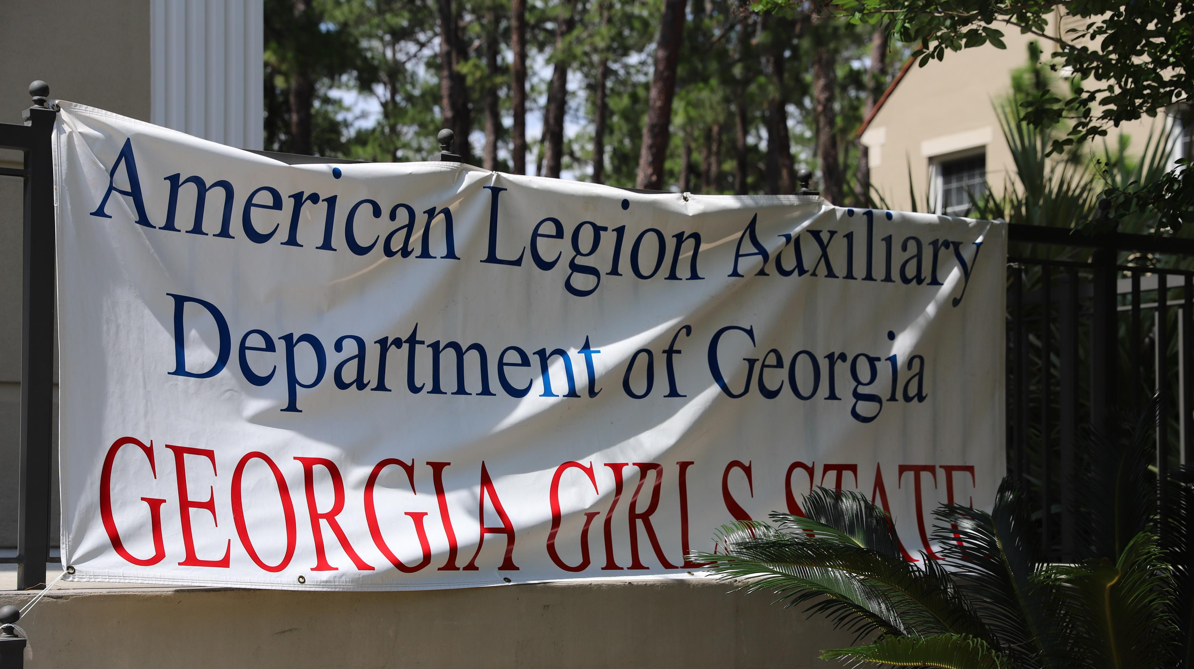

Slide 5
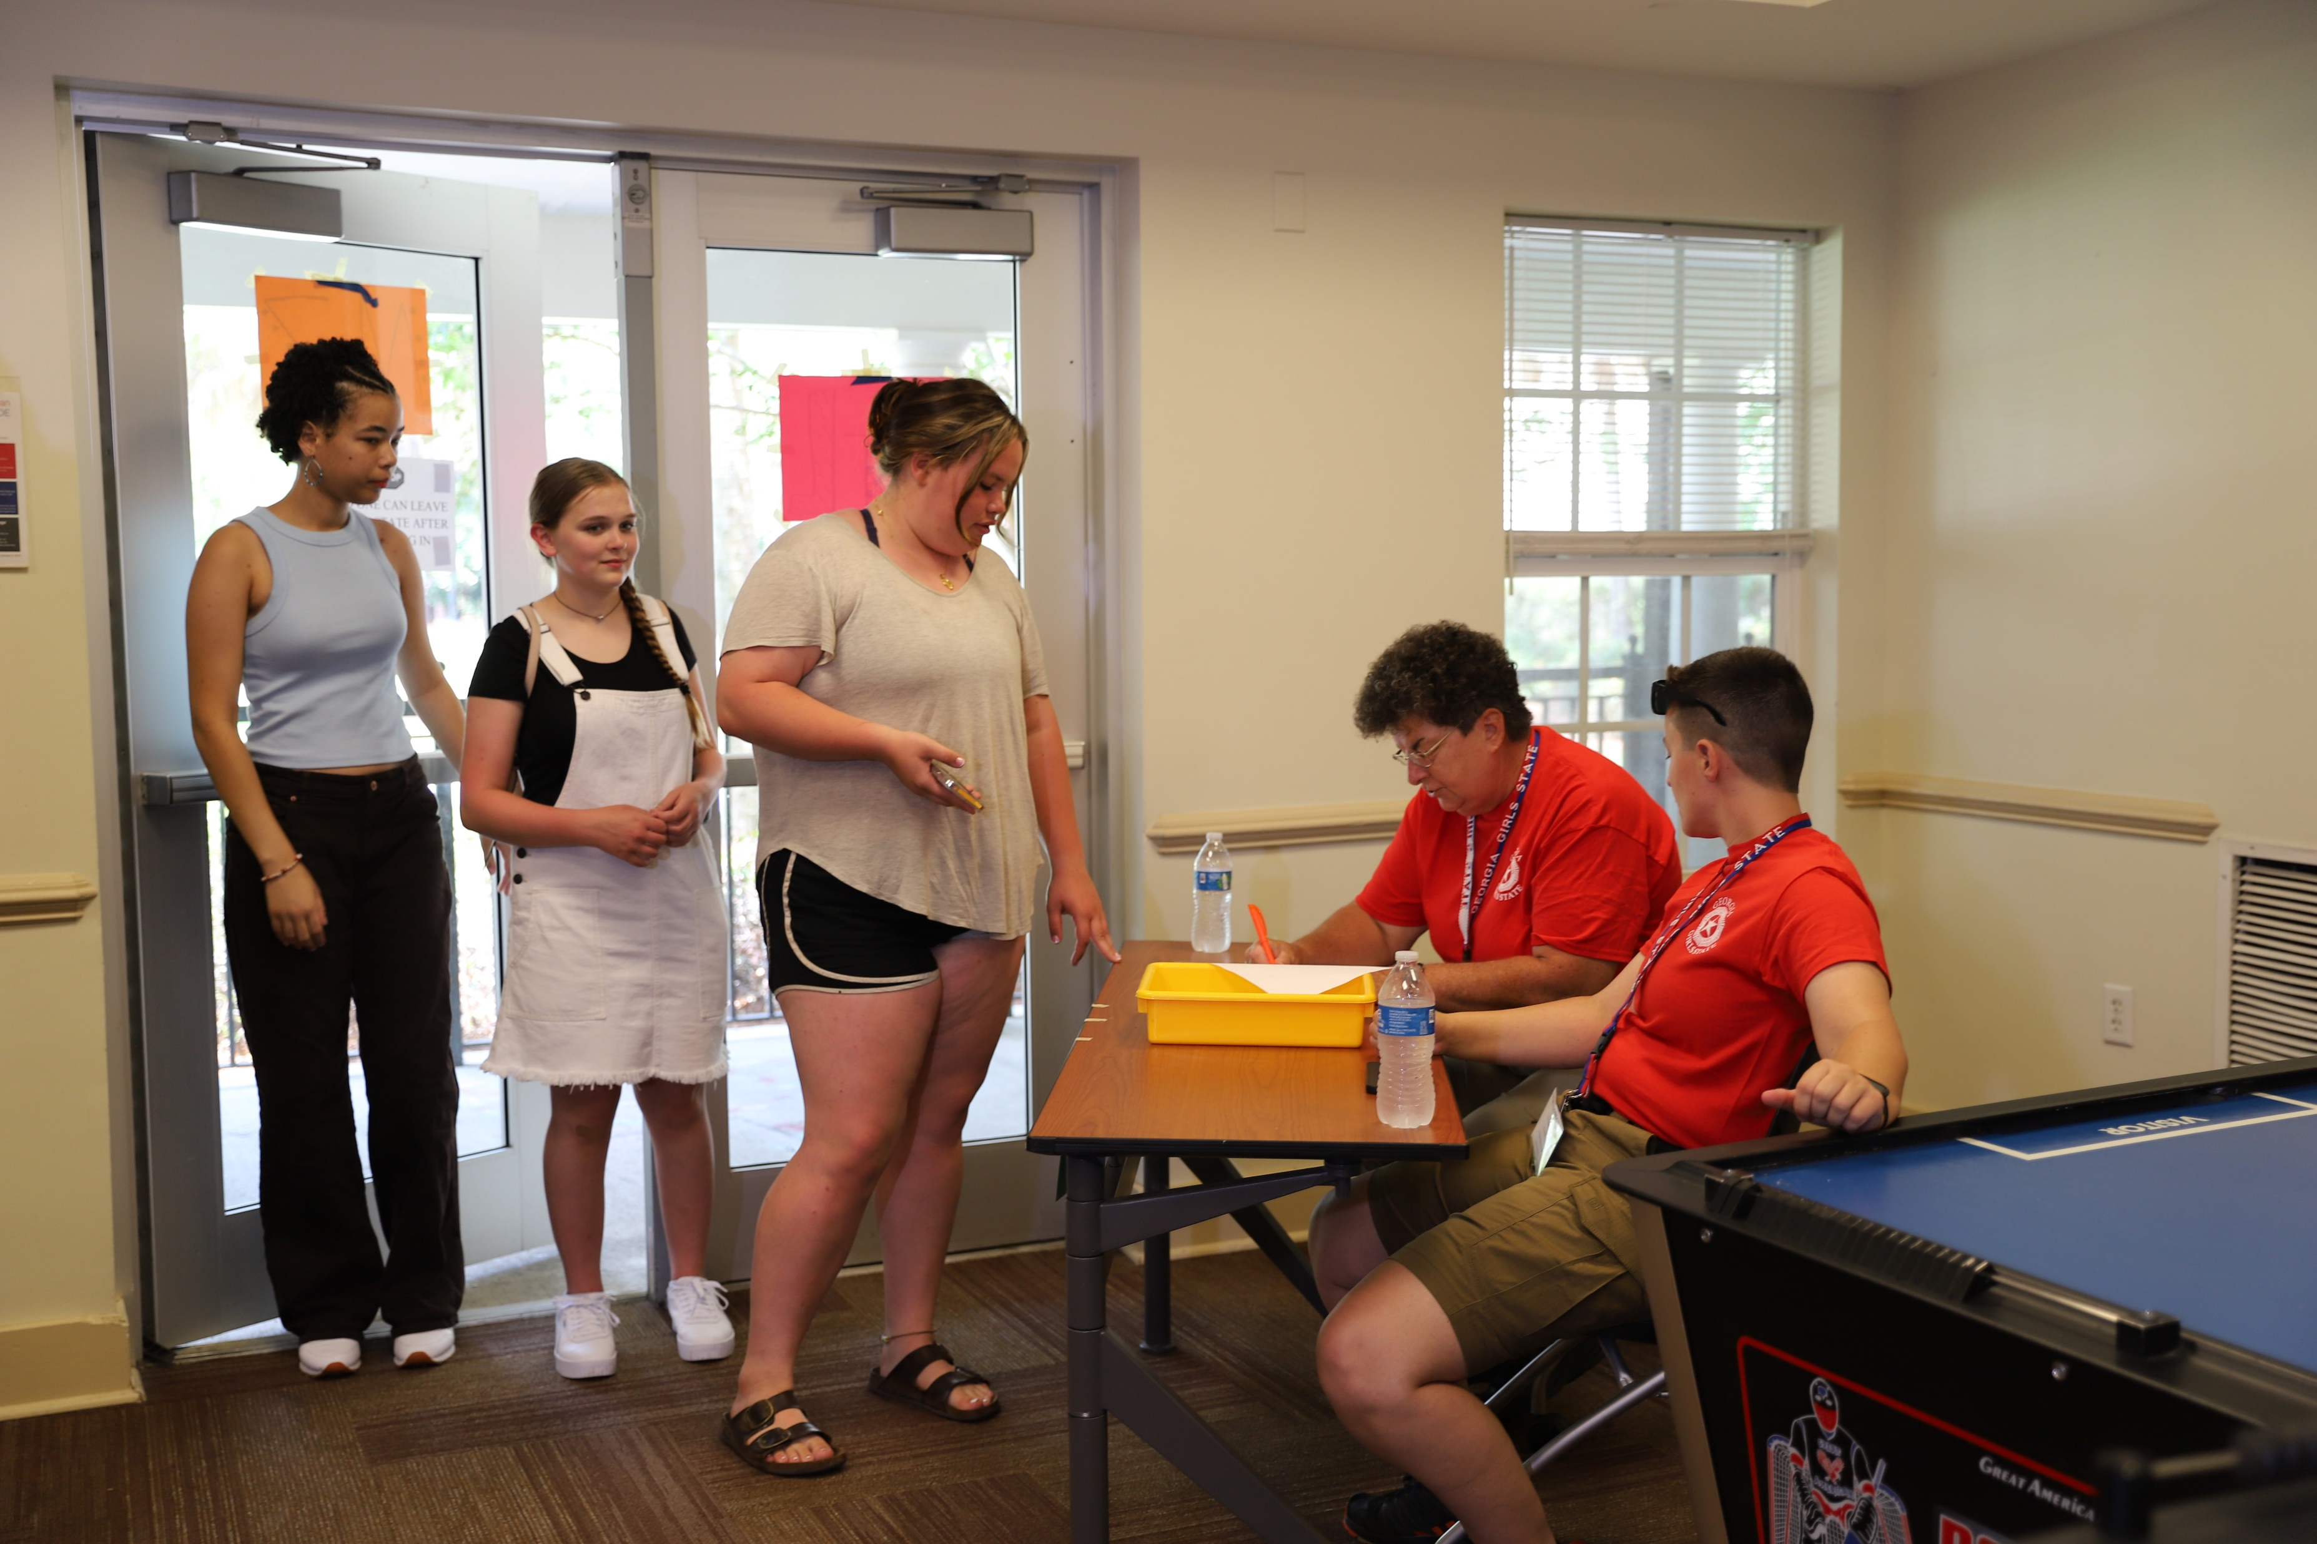
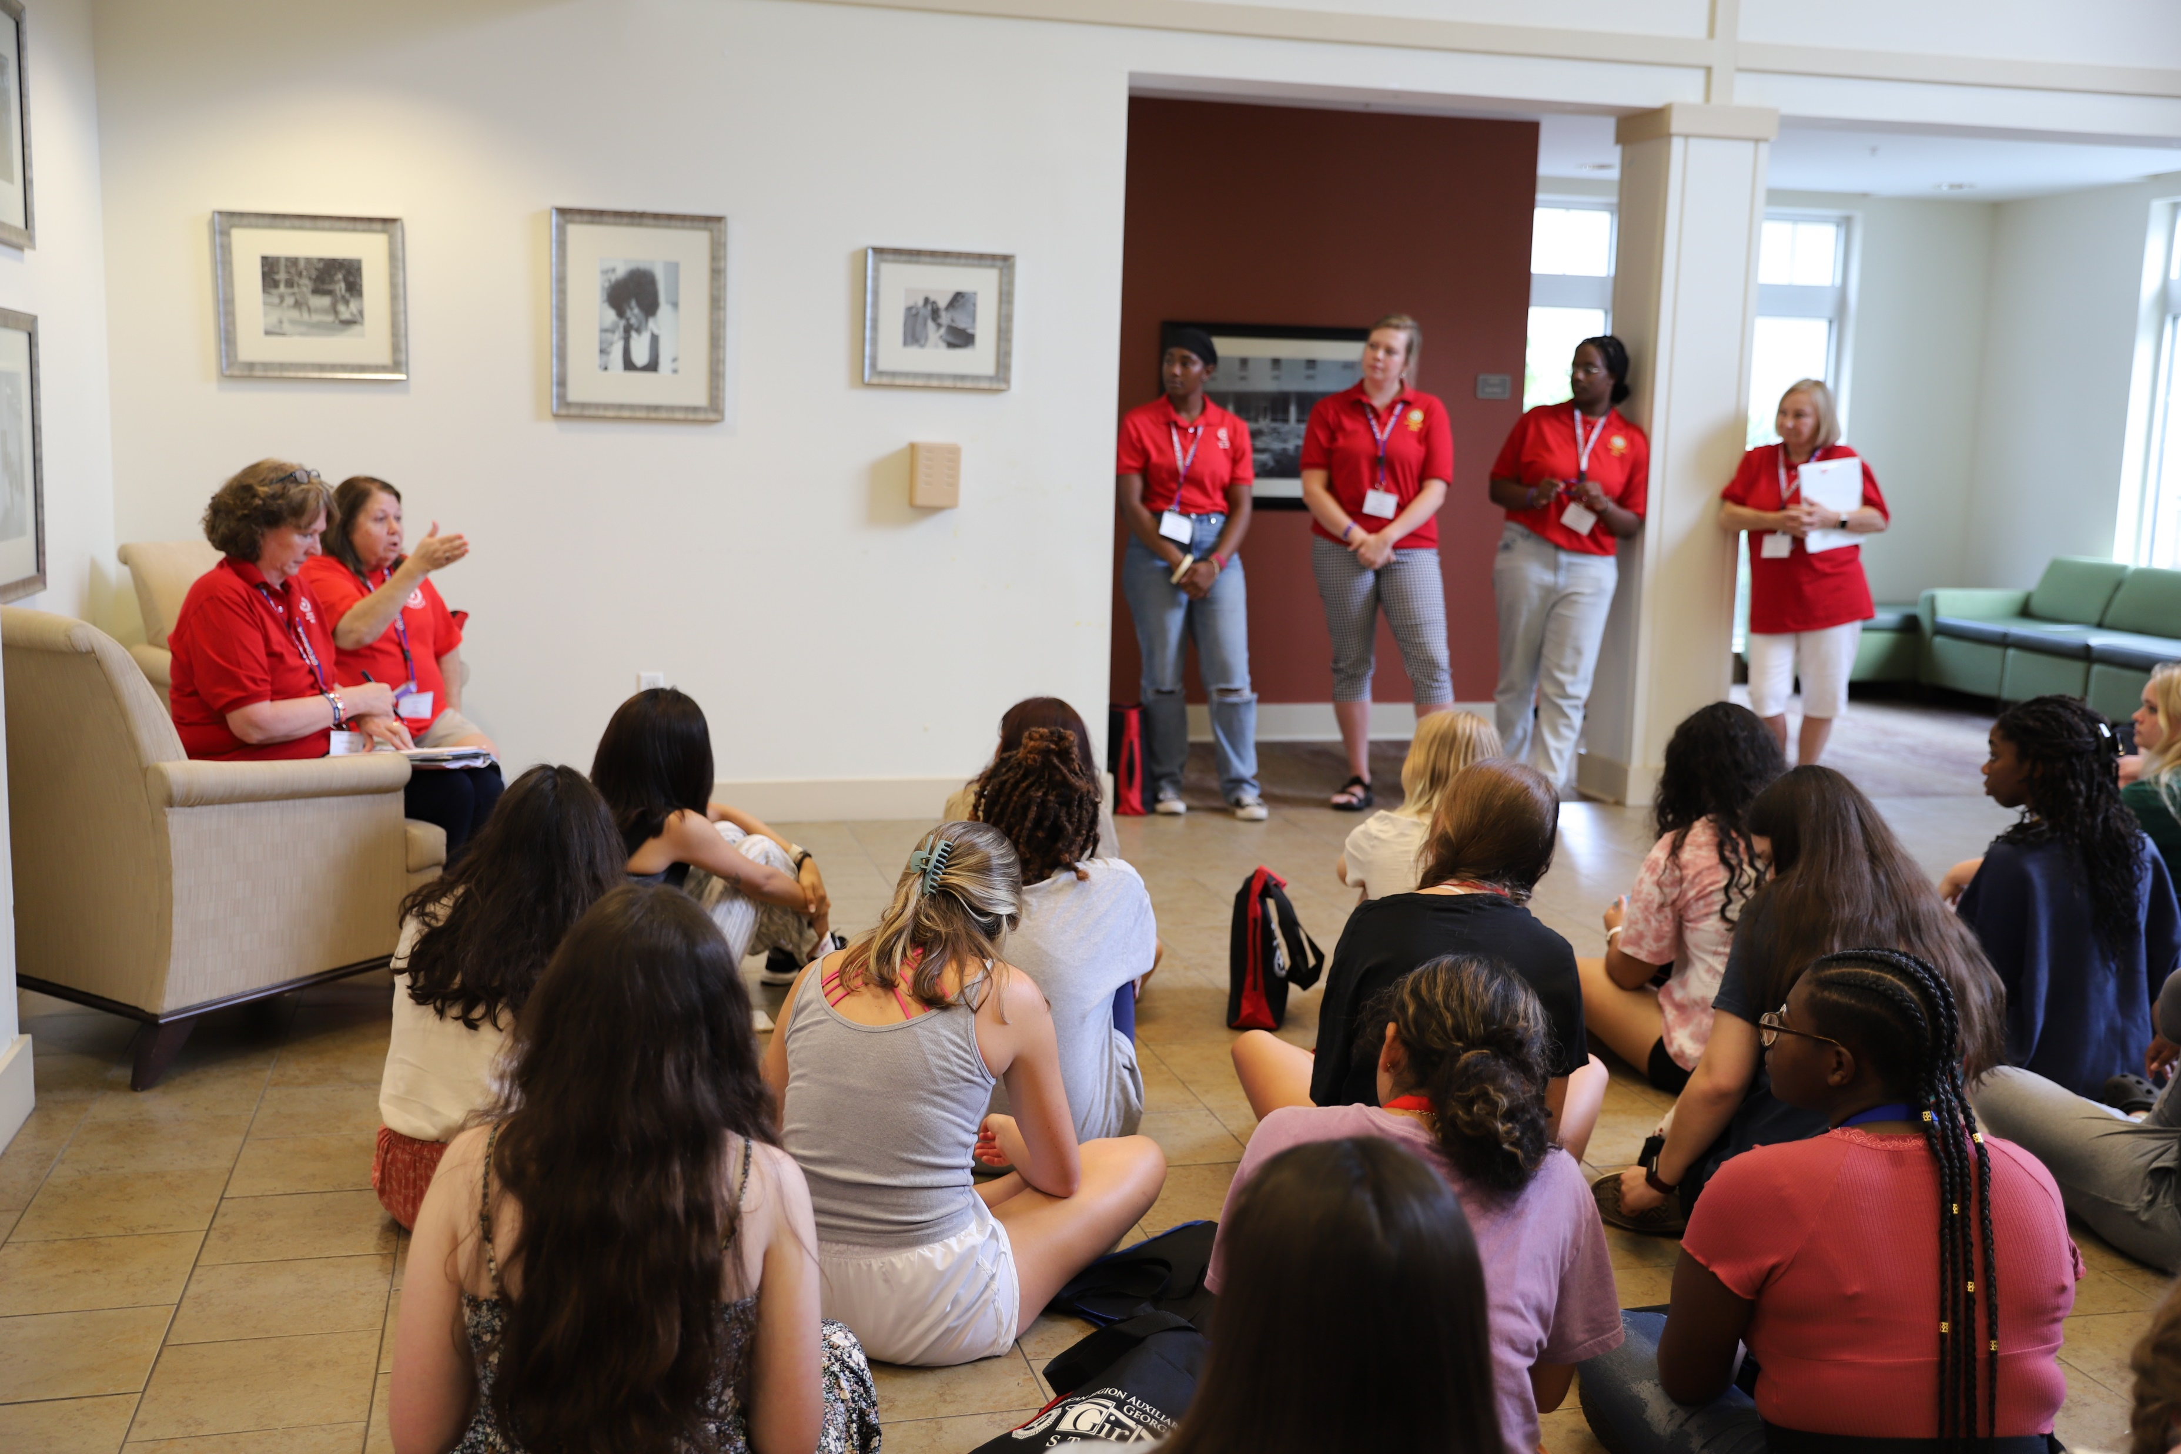
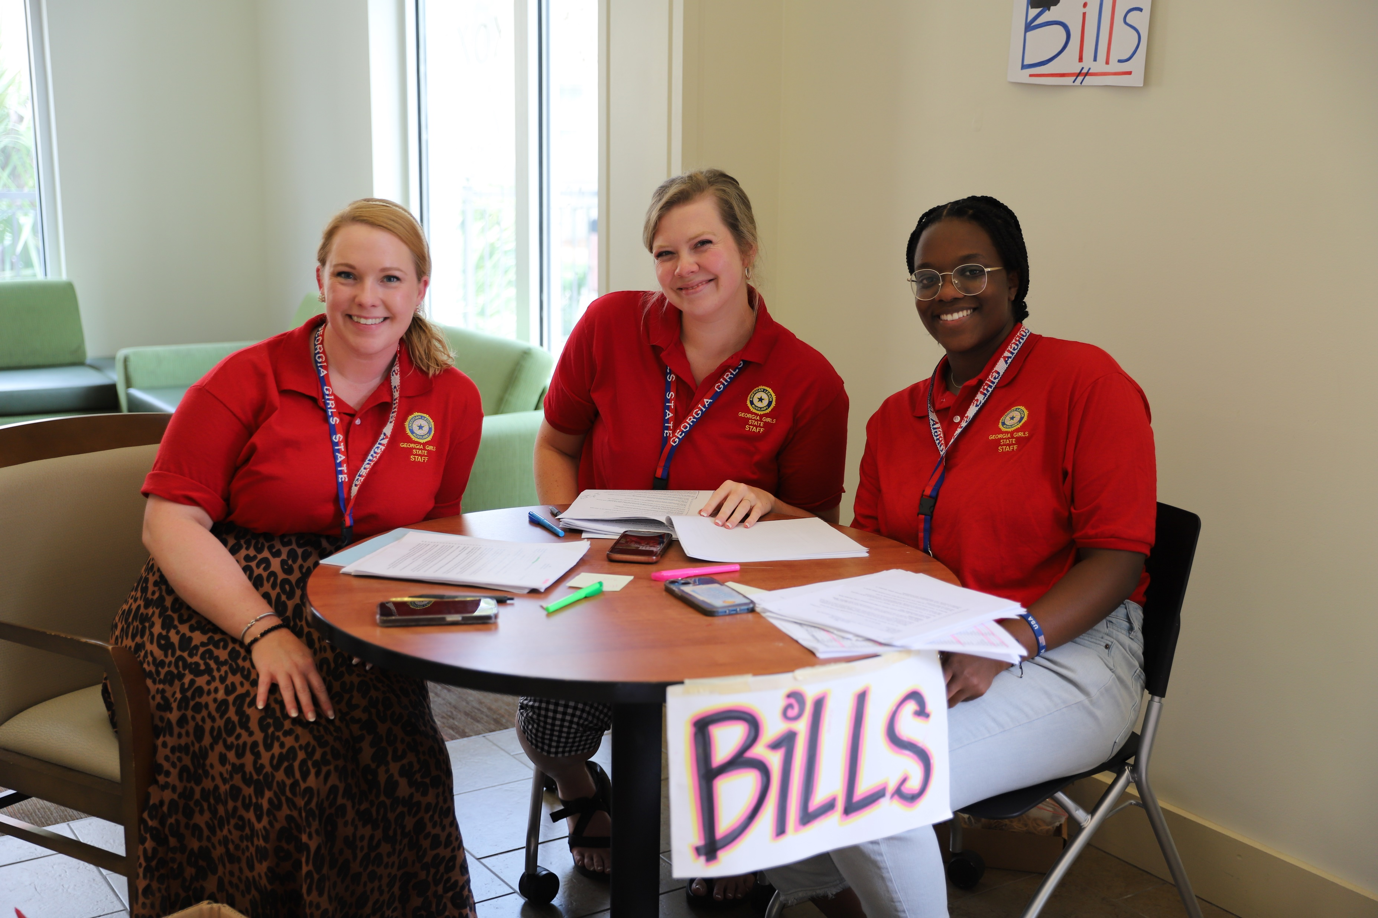
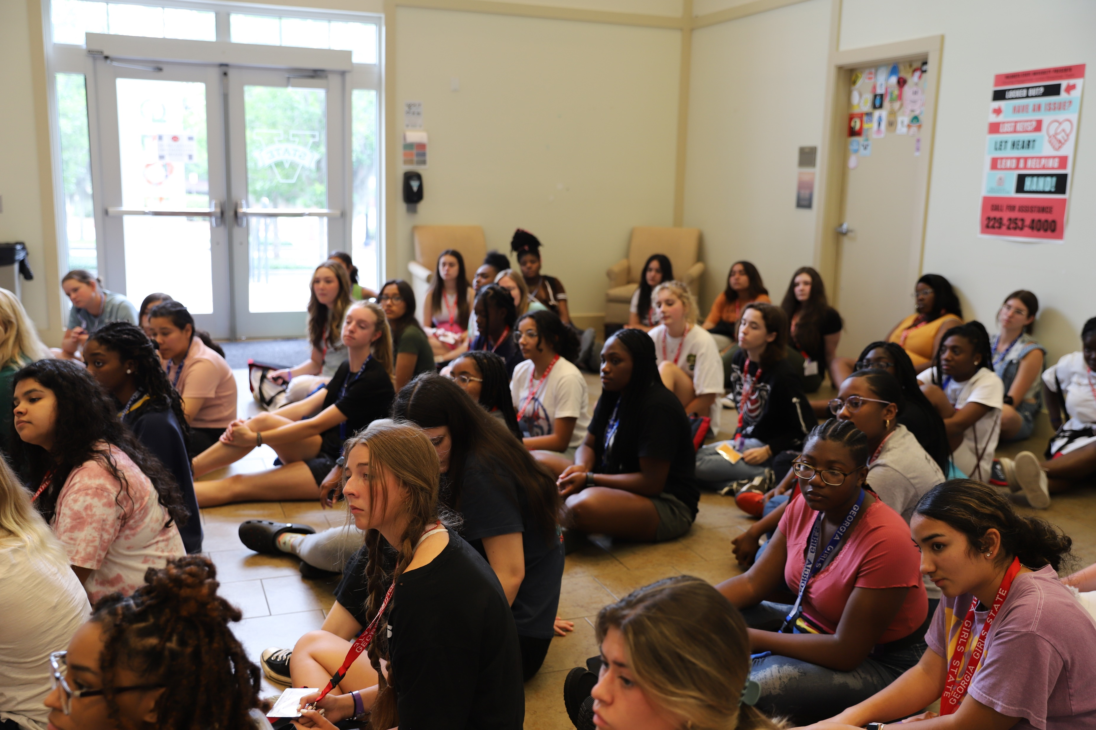
Sunday Registration 1:00 – 3:00
Orientation in City
Government Staff Collecting Bills
Orientation in City

Slide 6
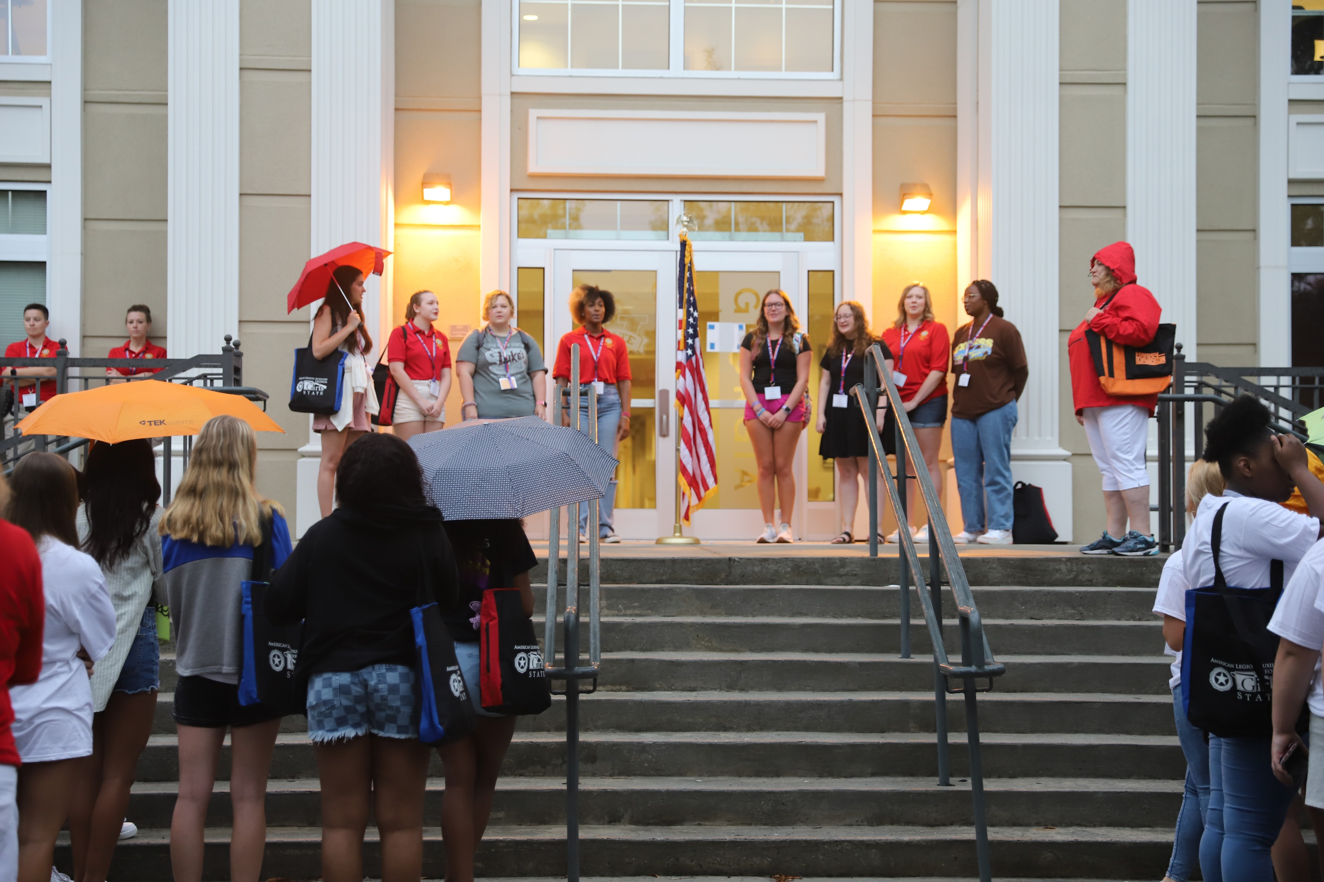
Morning Flag Ceremony

Slide 7
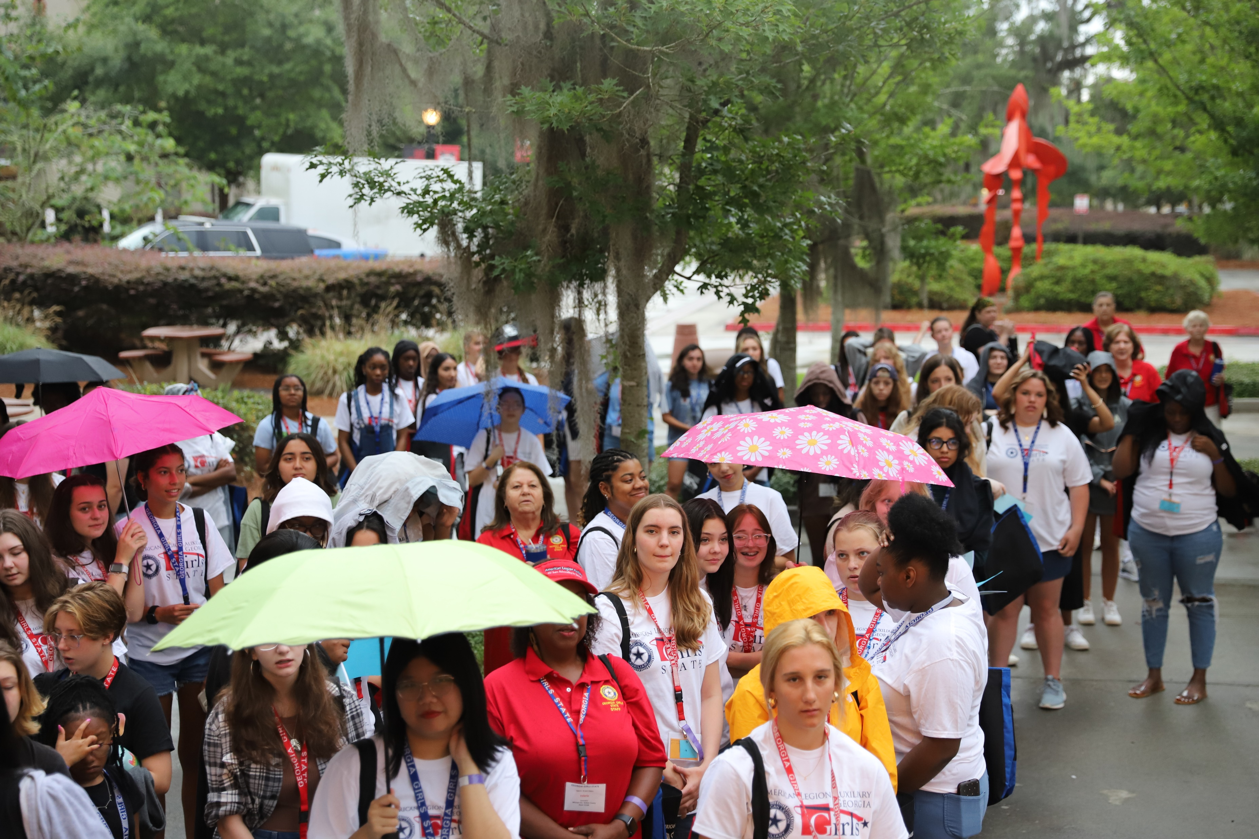

Slide 8
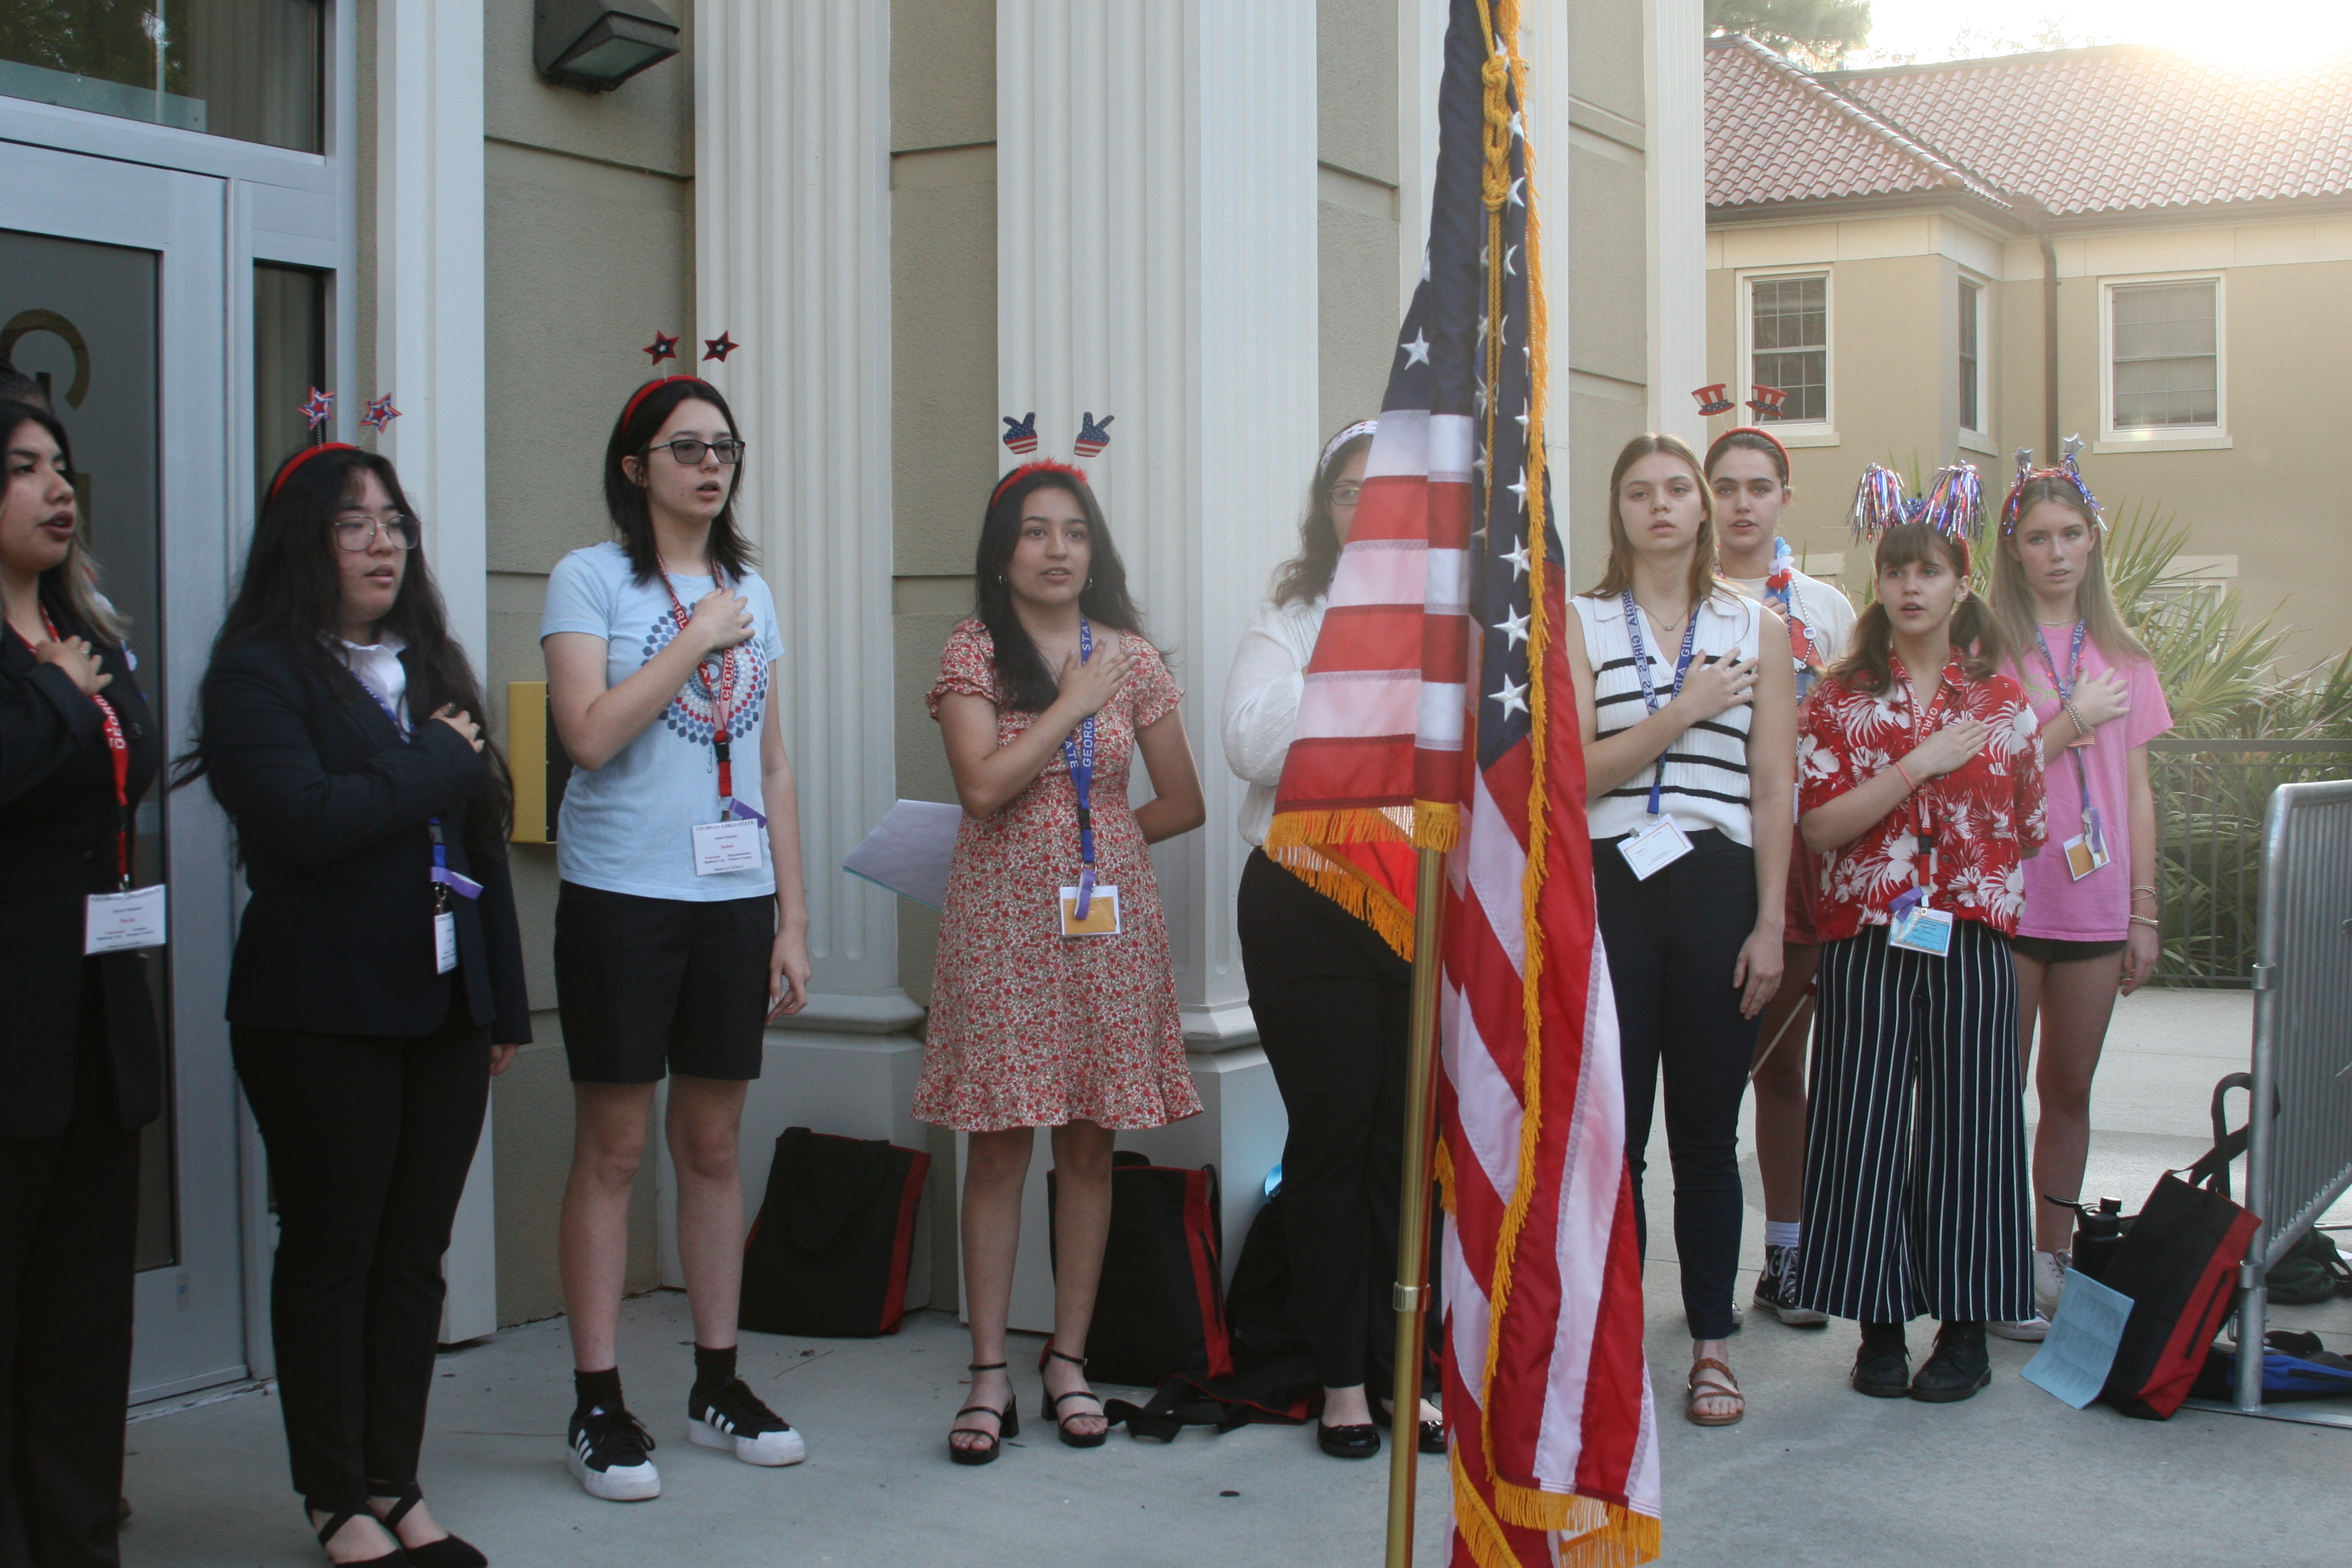

Slide 9
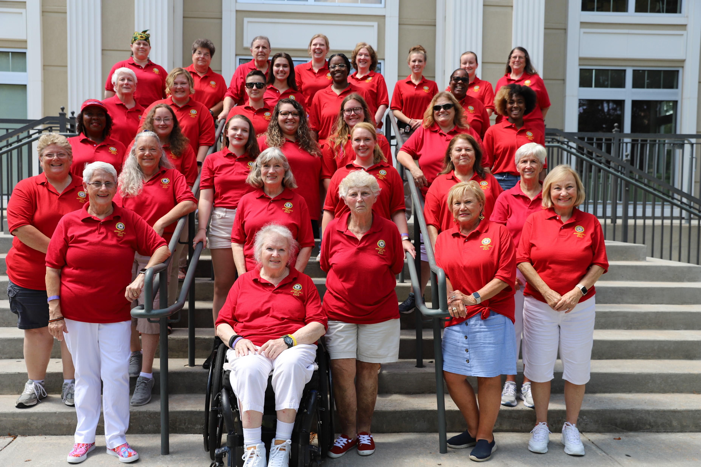
S
T
A
F
F

Slide 10
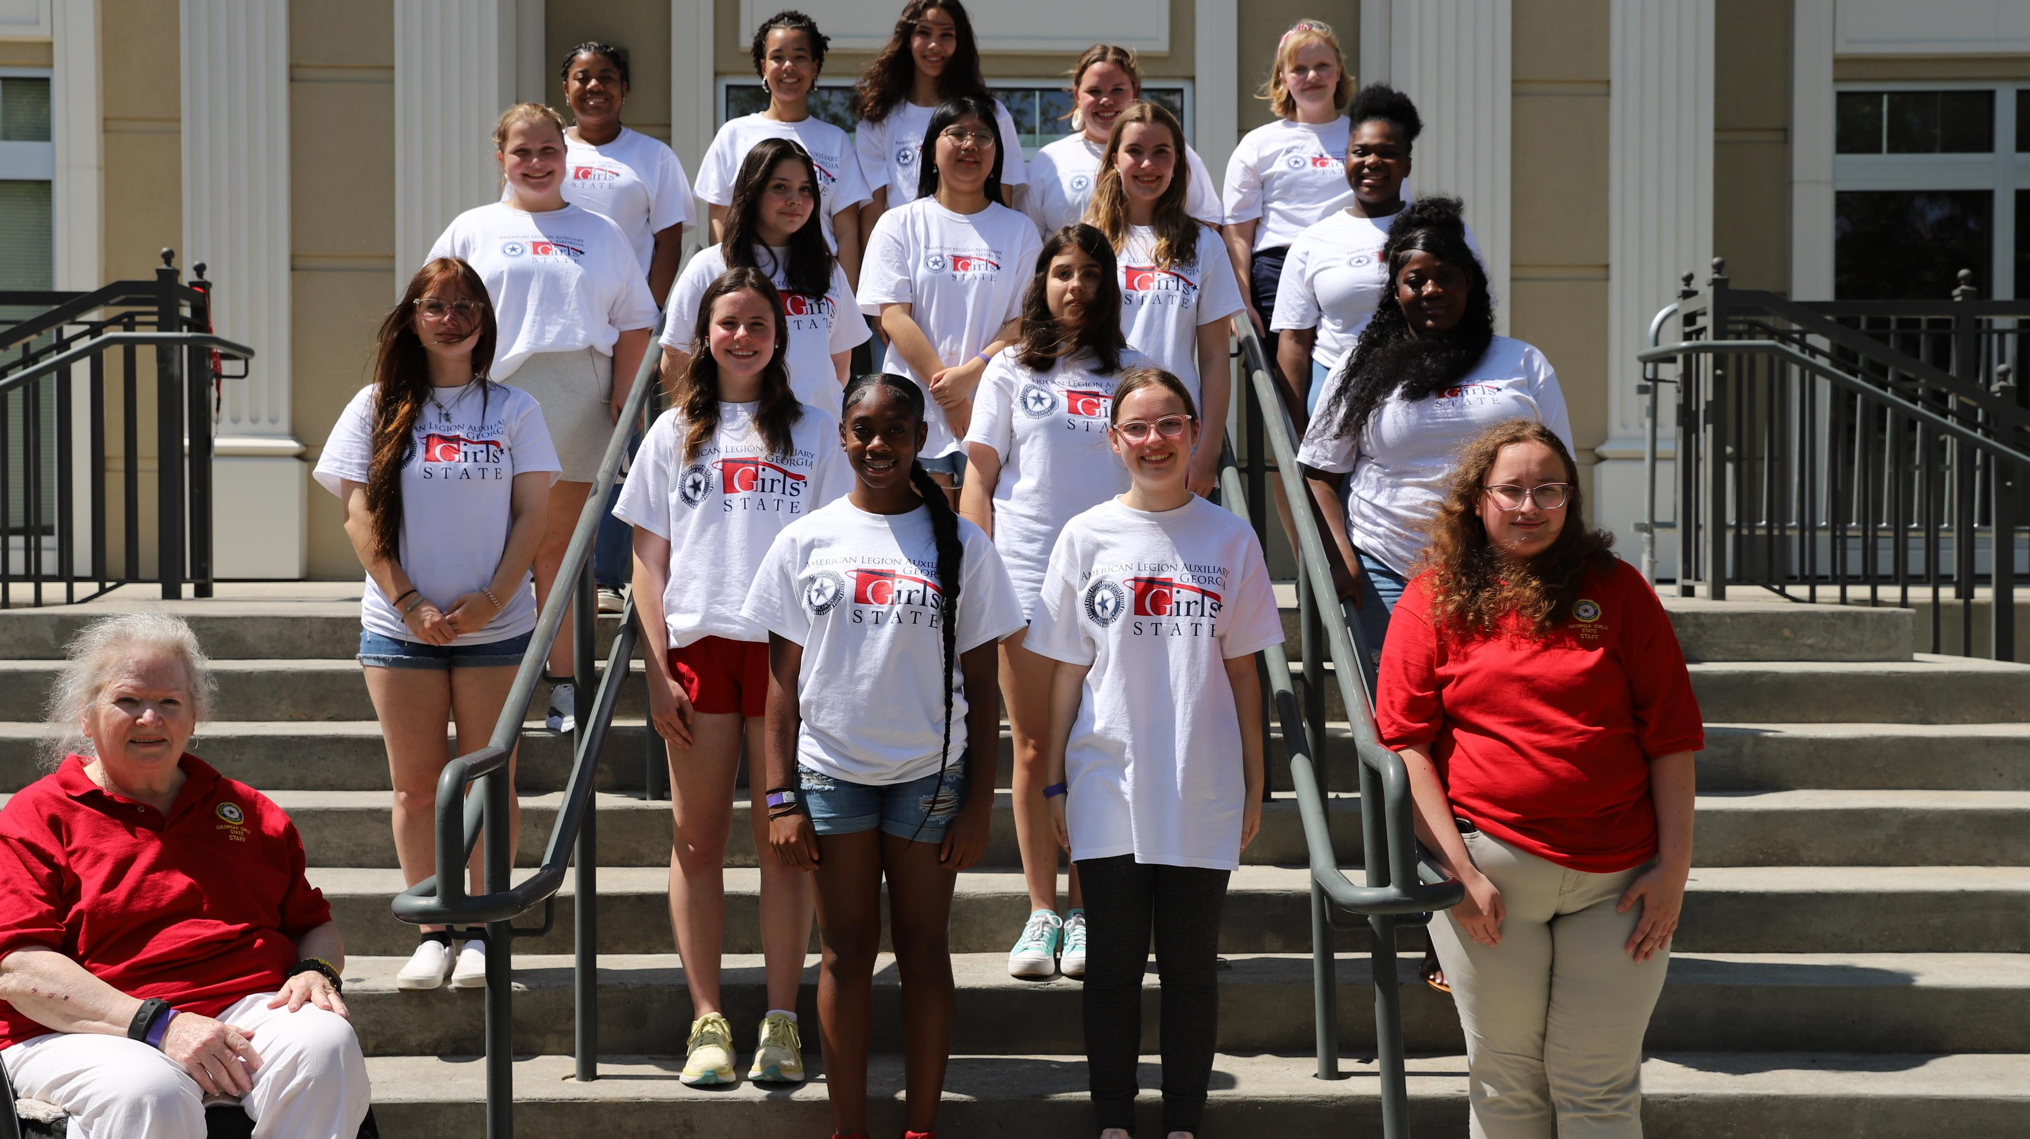

Slide 11
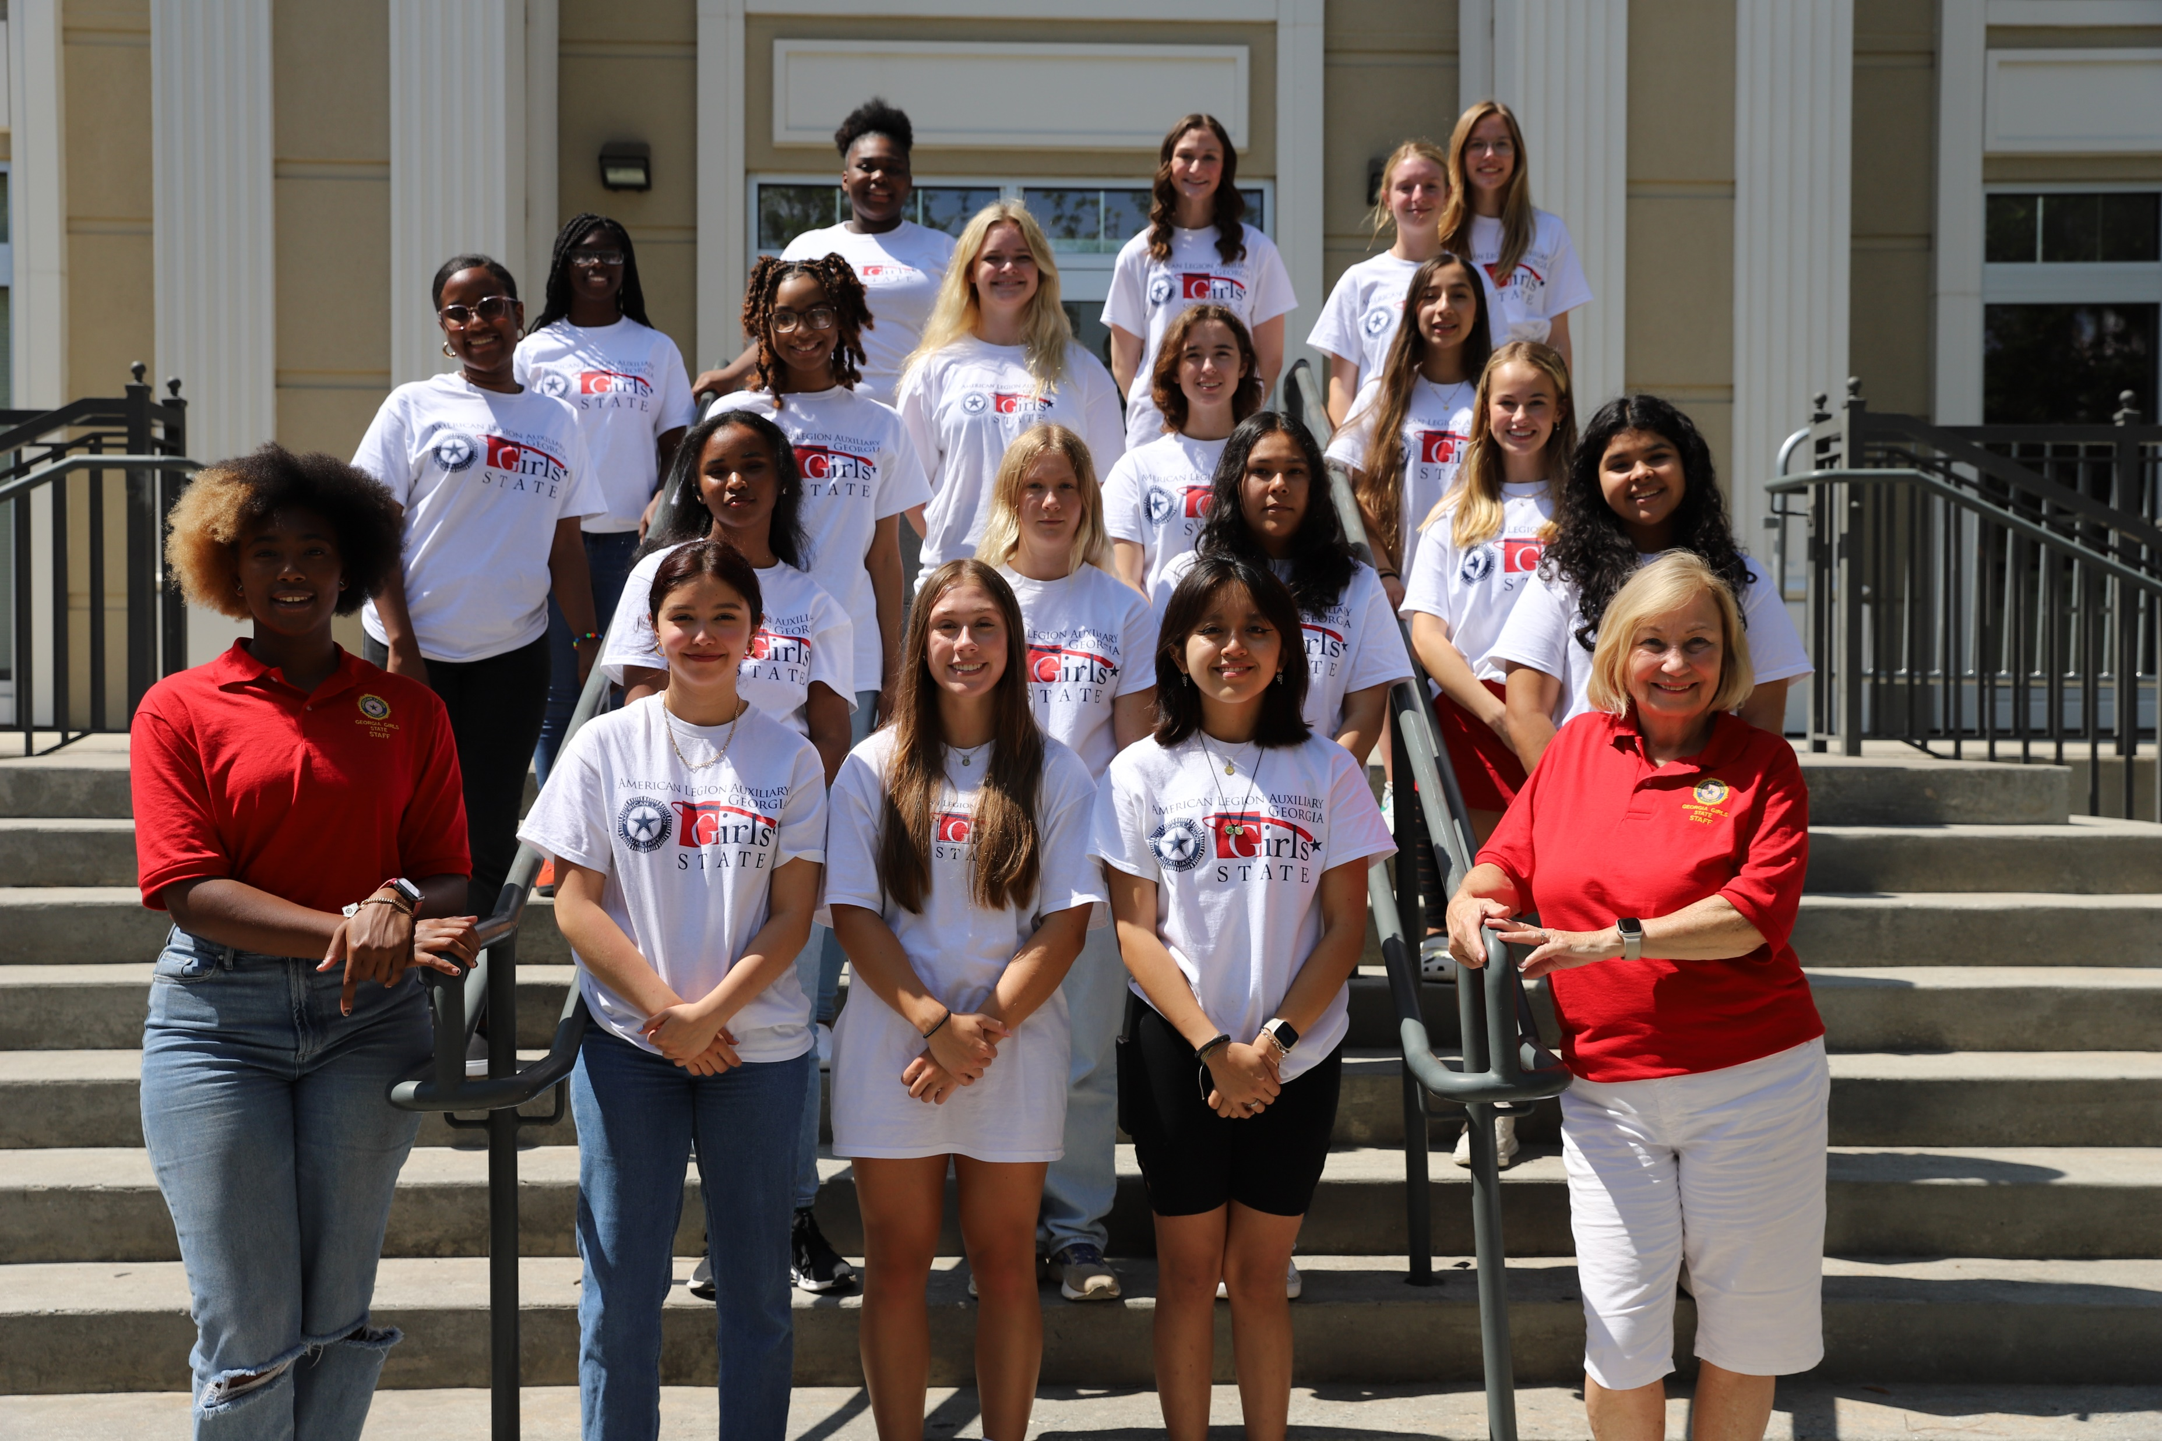

Slide 12
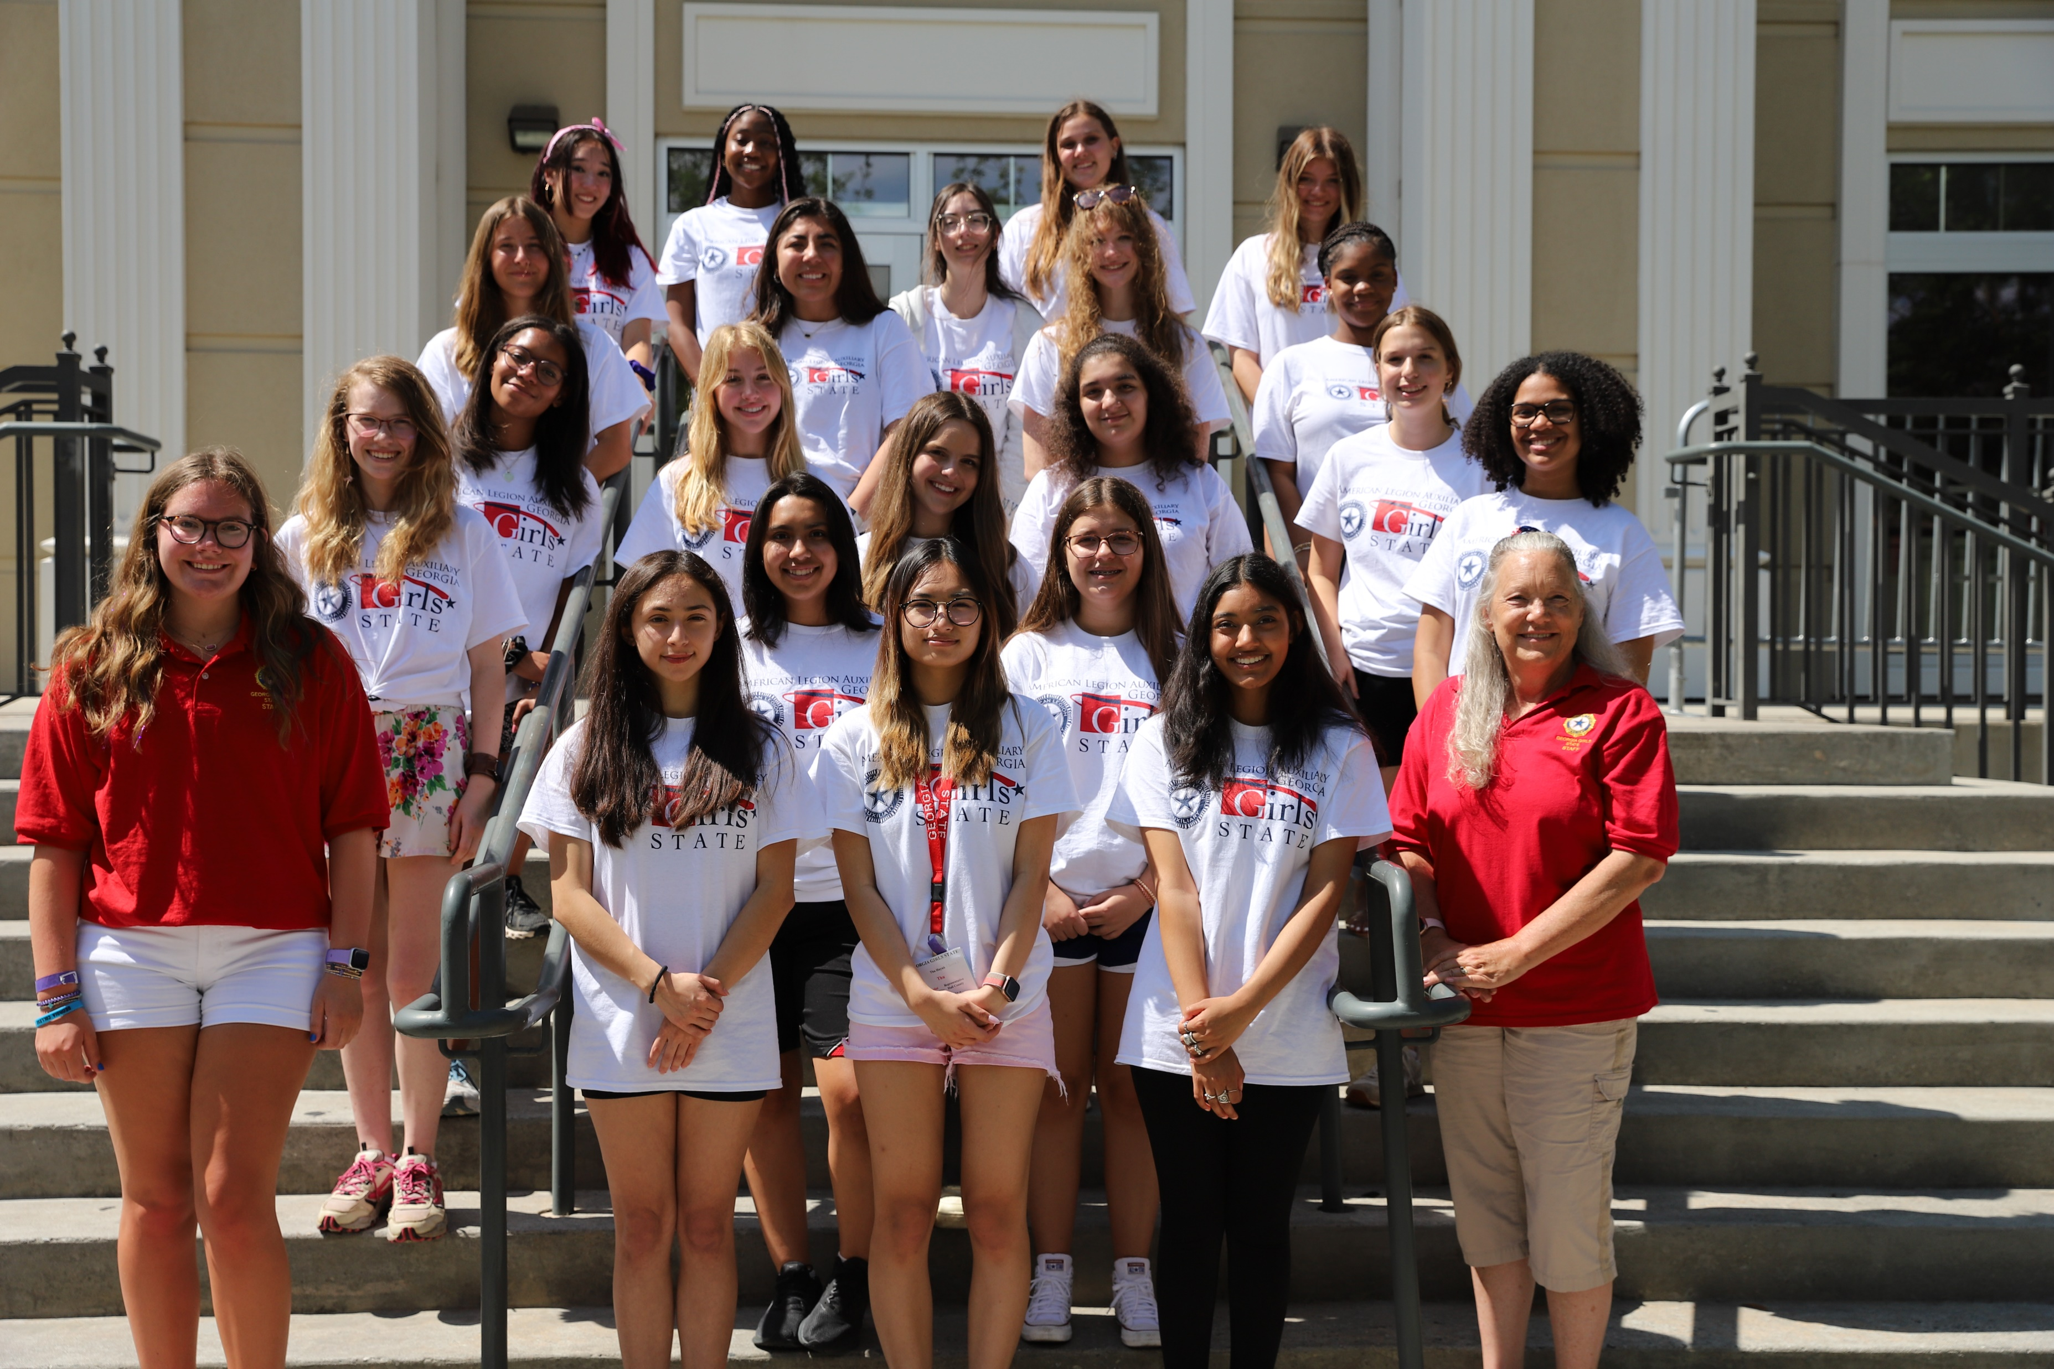

Slide 13
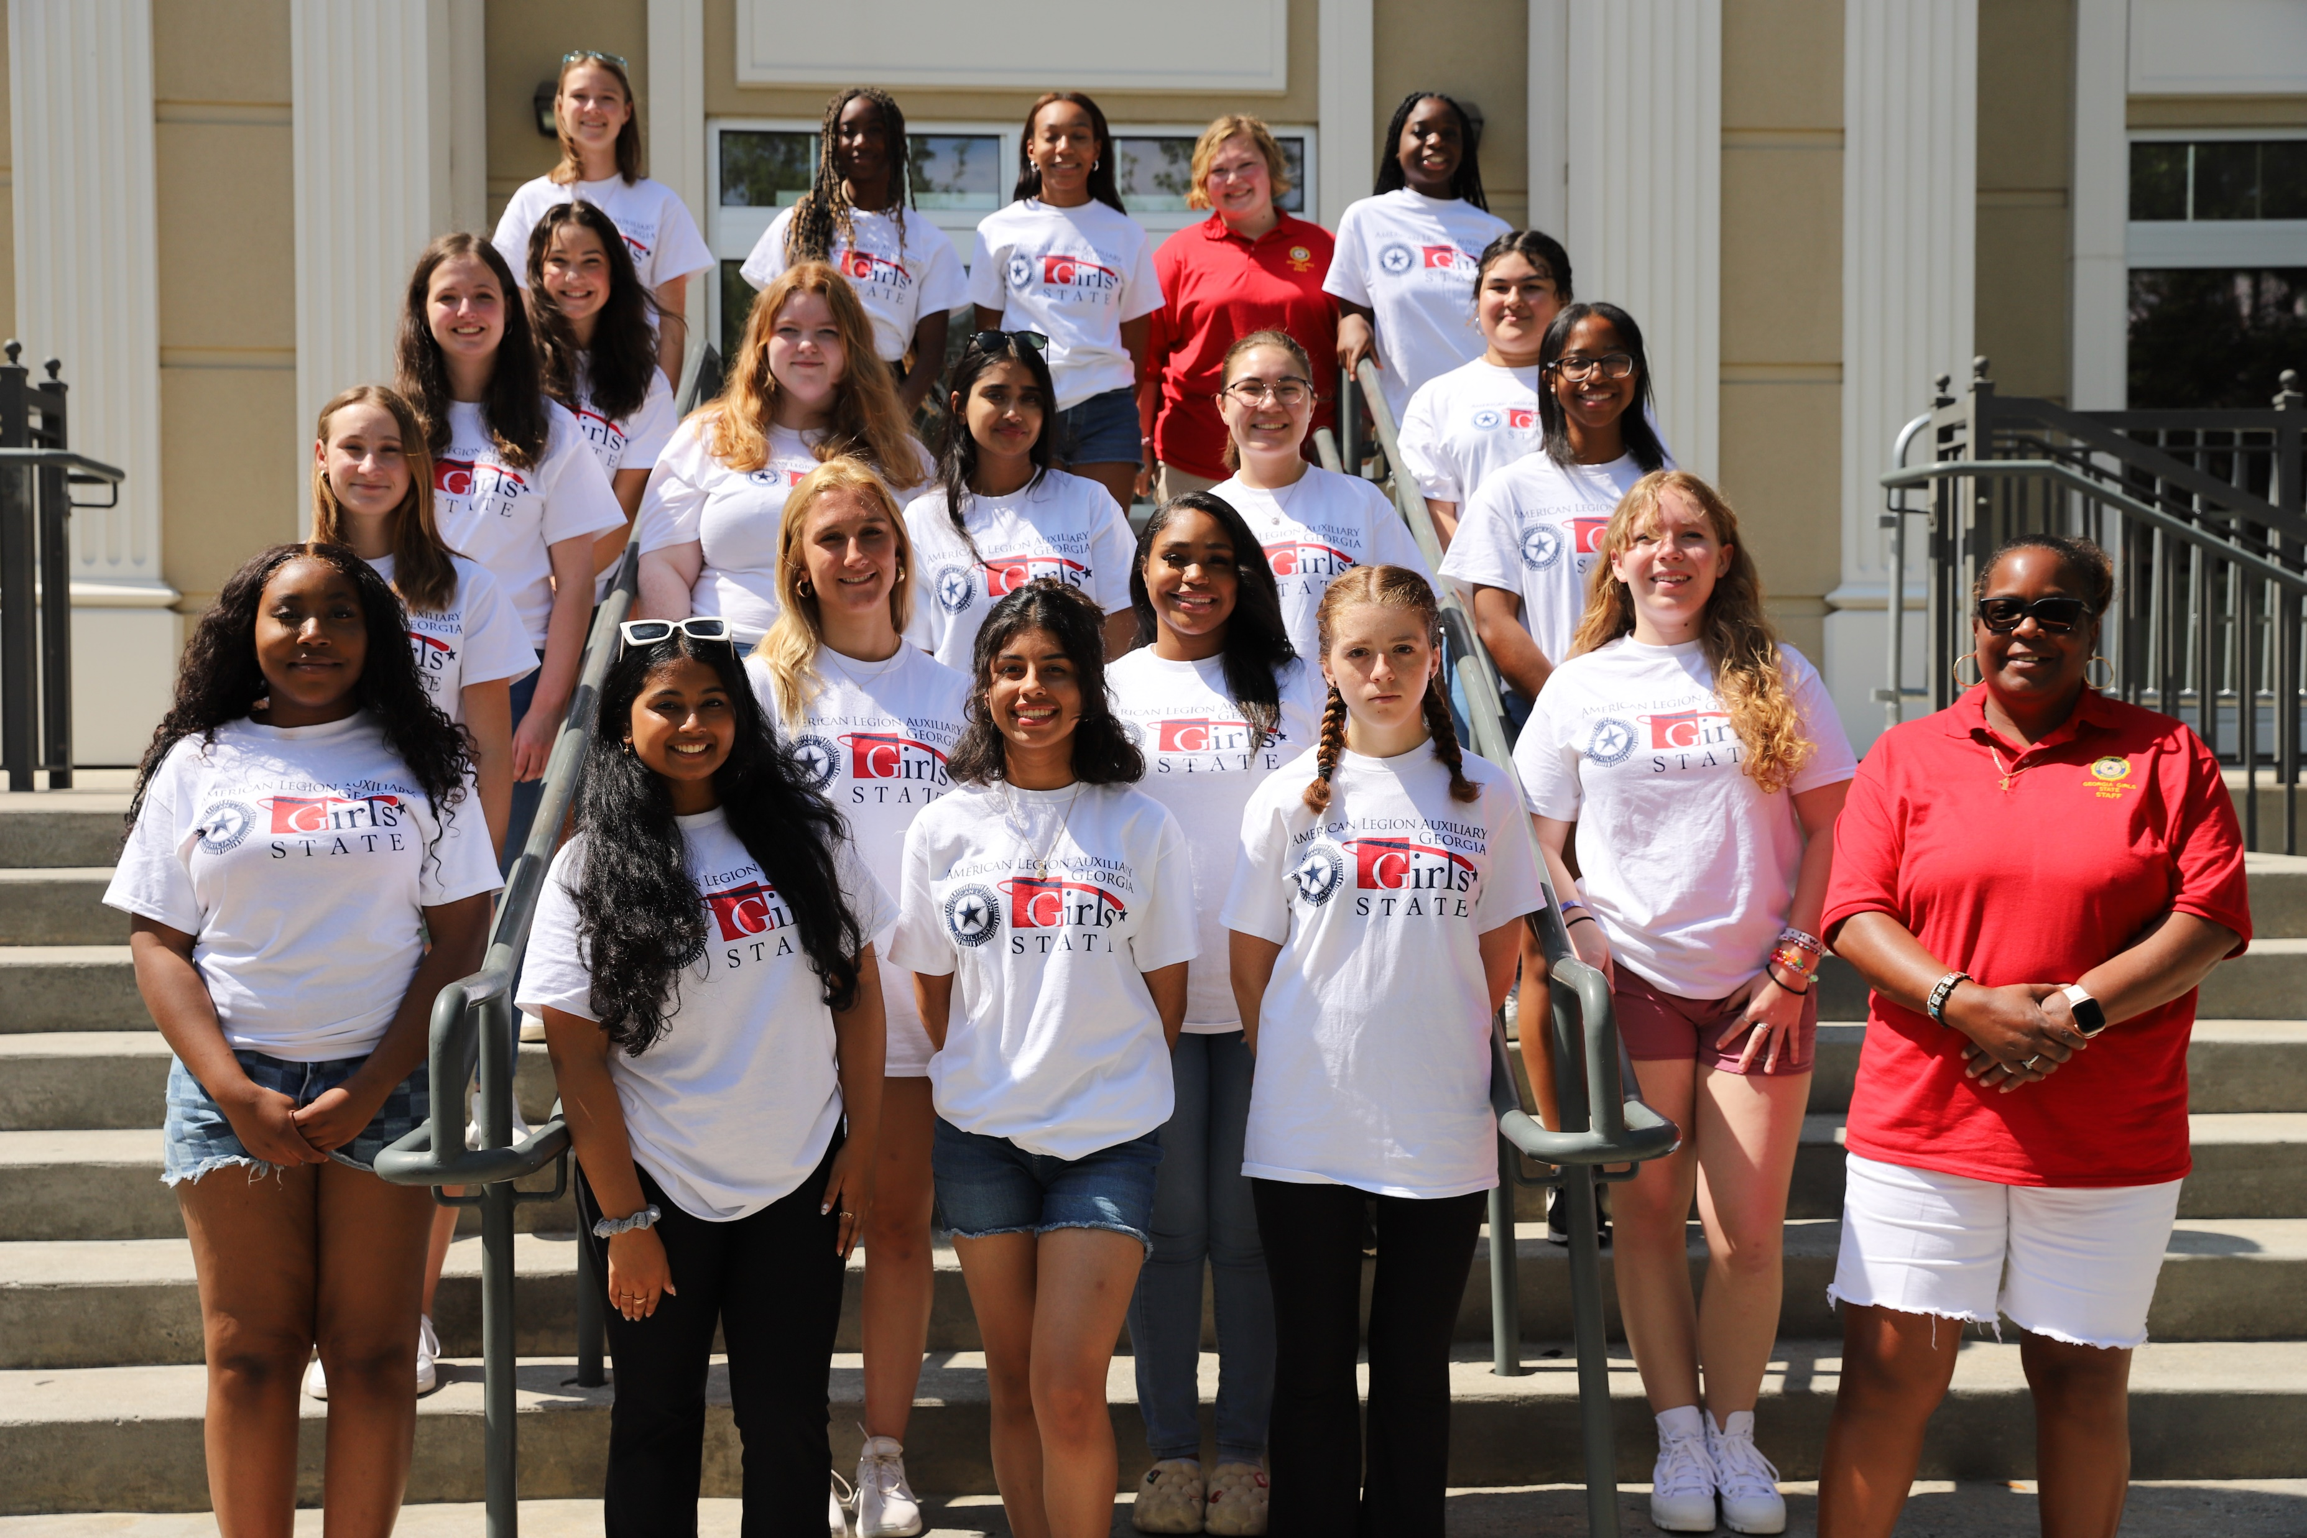

Slide 14
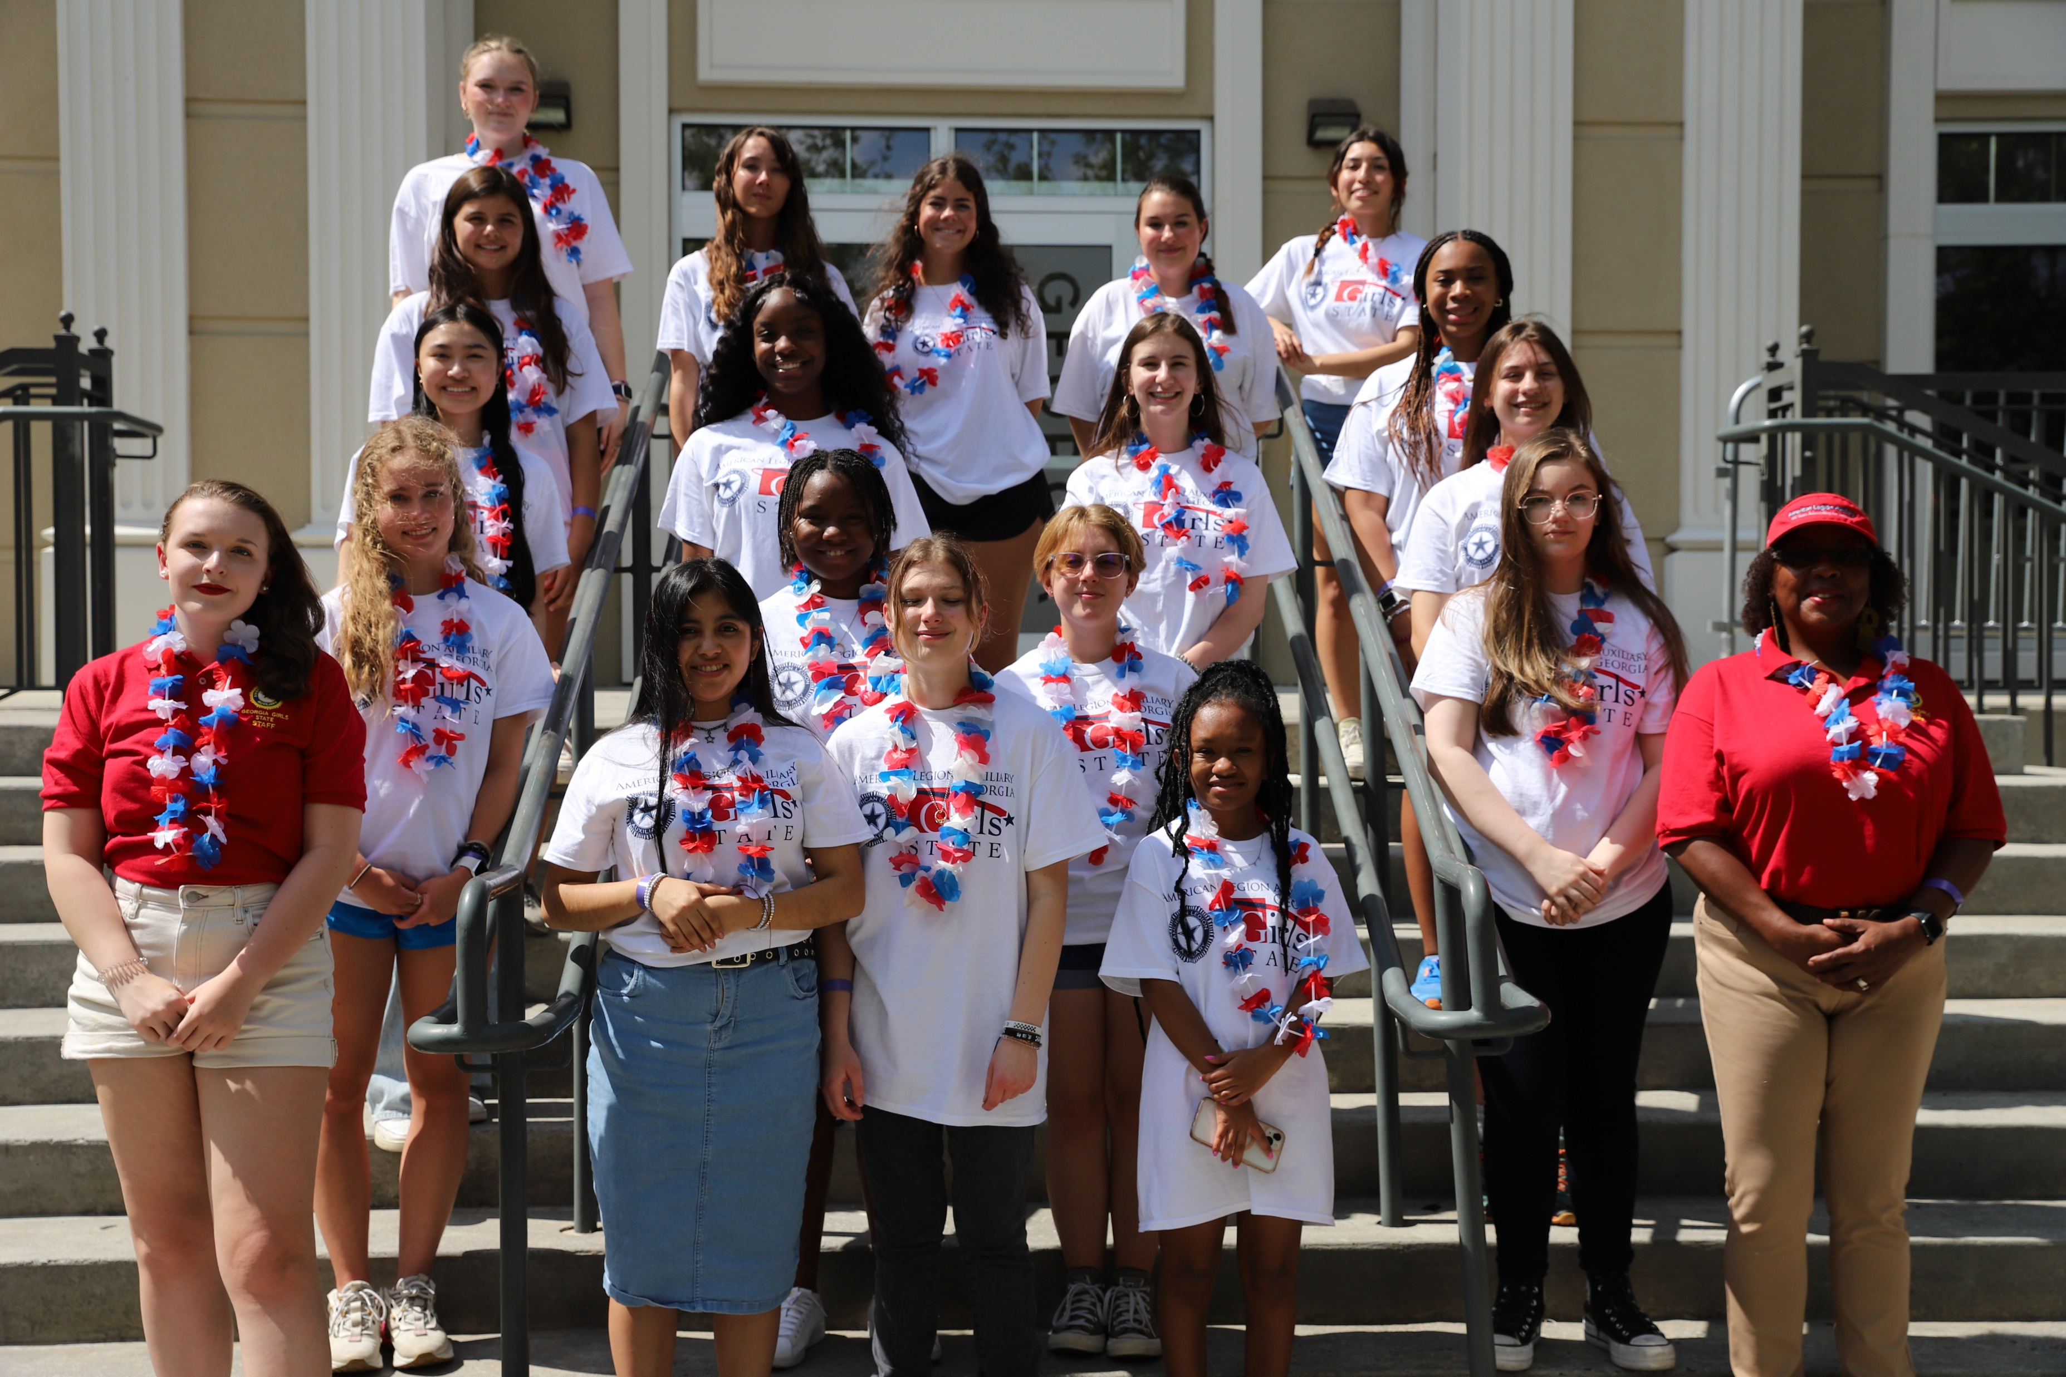

Slide 15
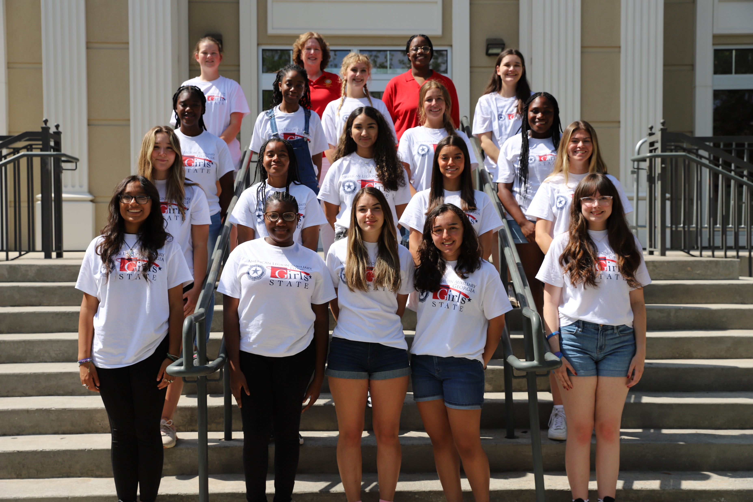

Slide 16
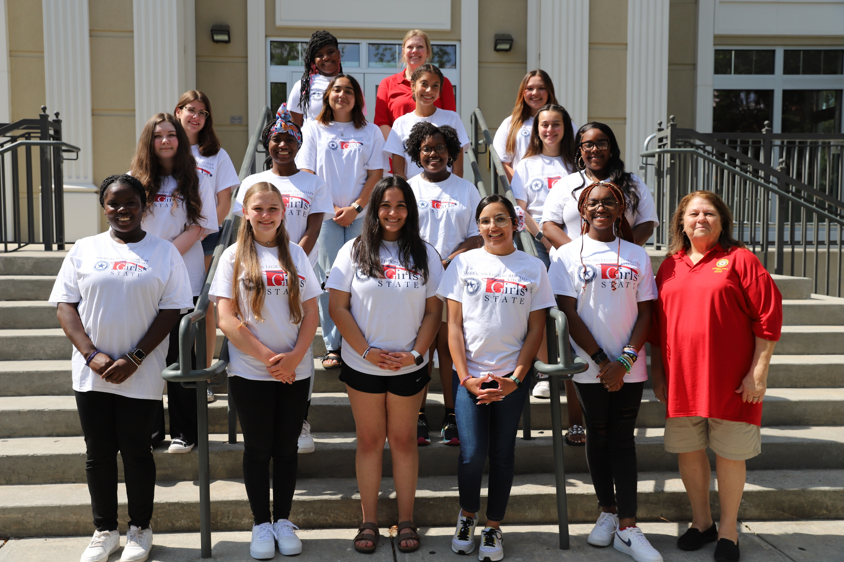

Slide 17
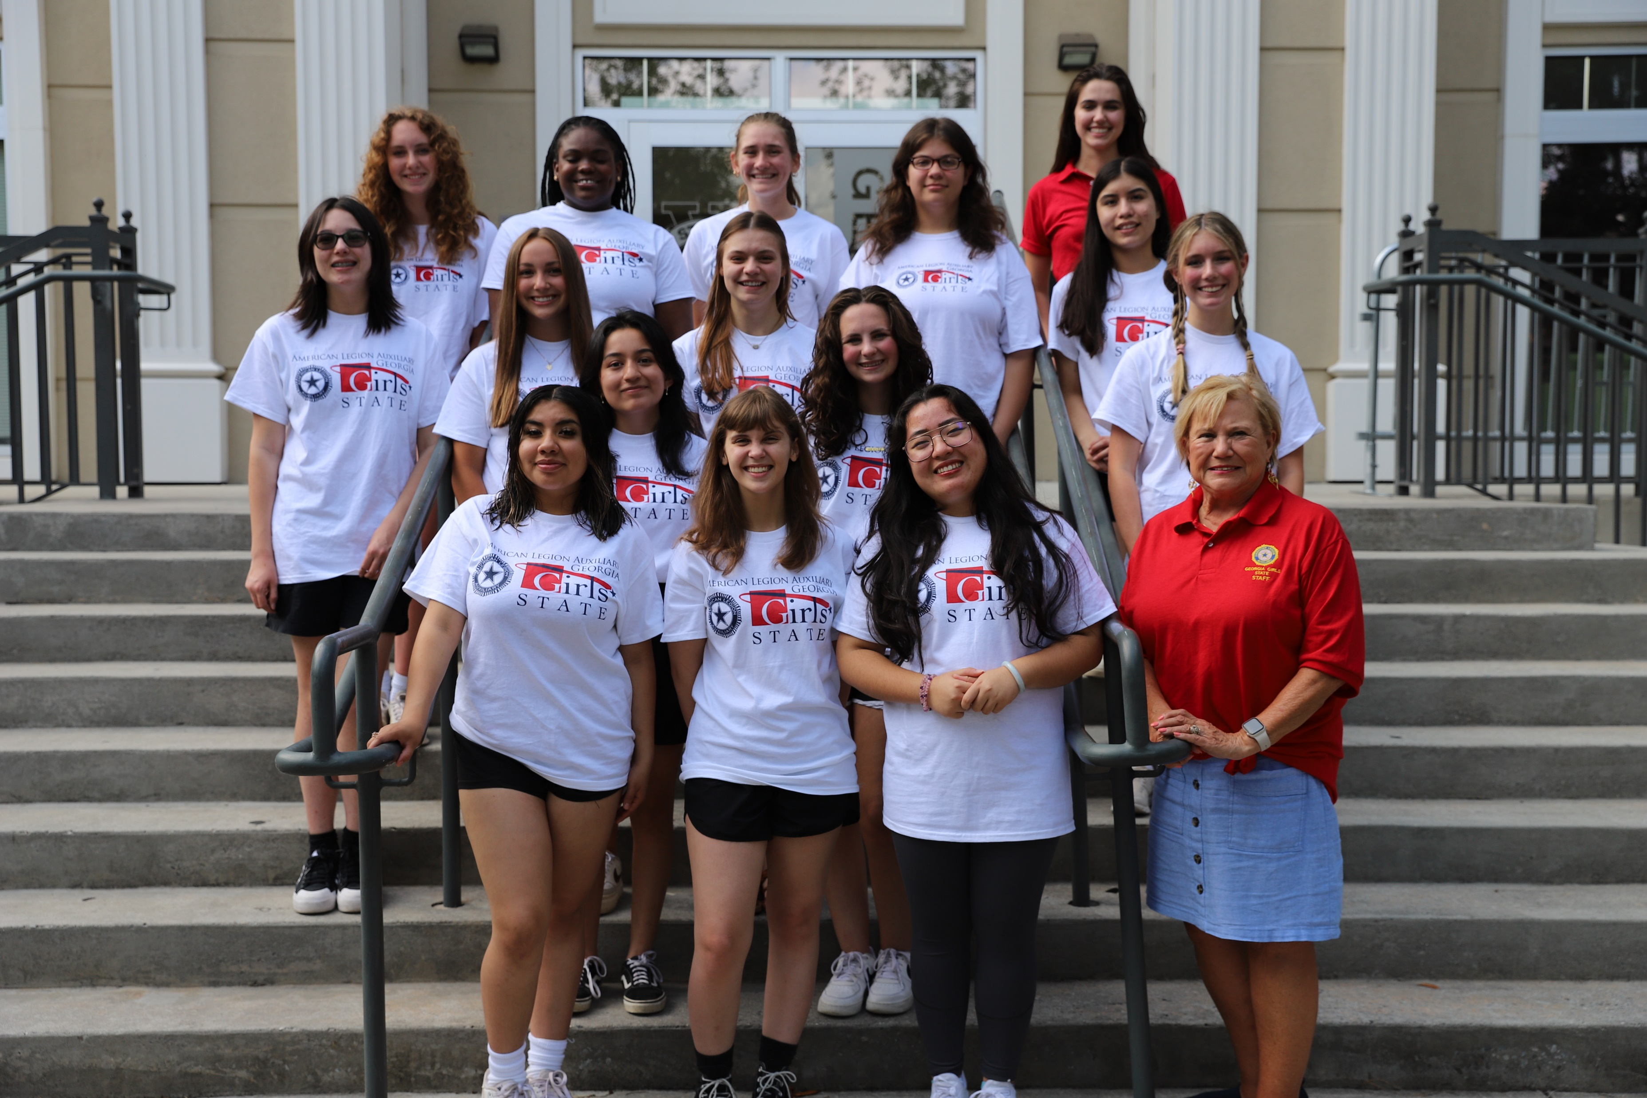

Slide 18
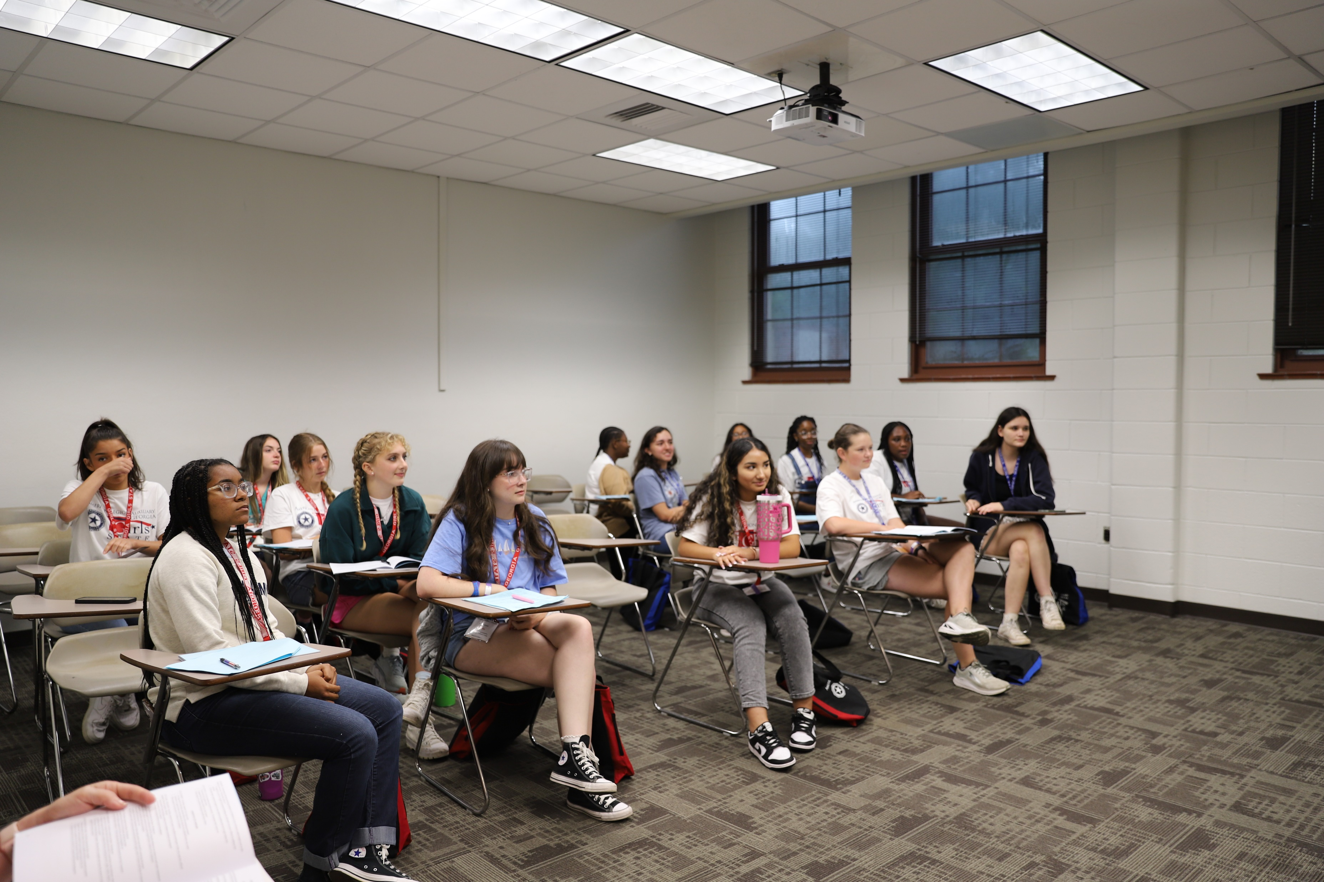
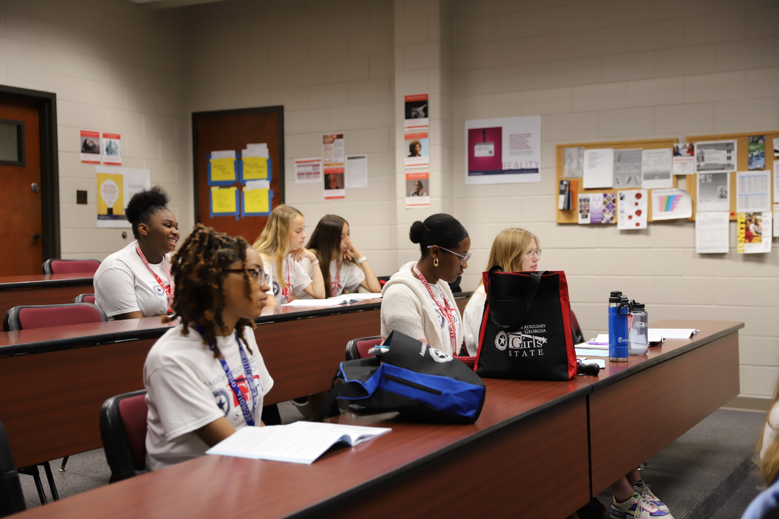
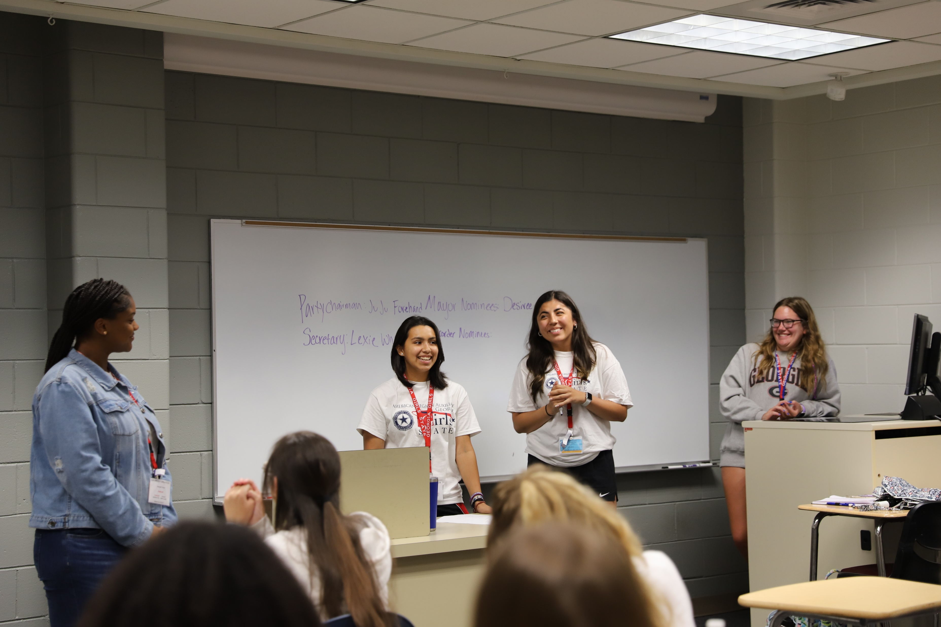
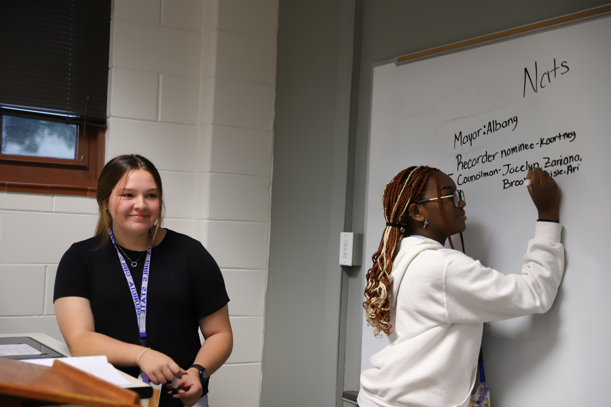
Monday: Nominations of City Officers

Slide 19
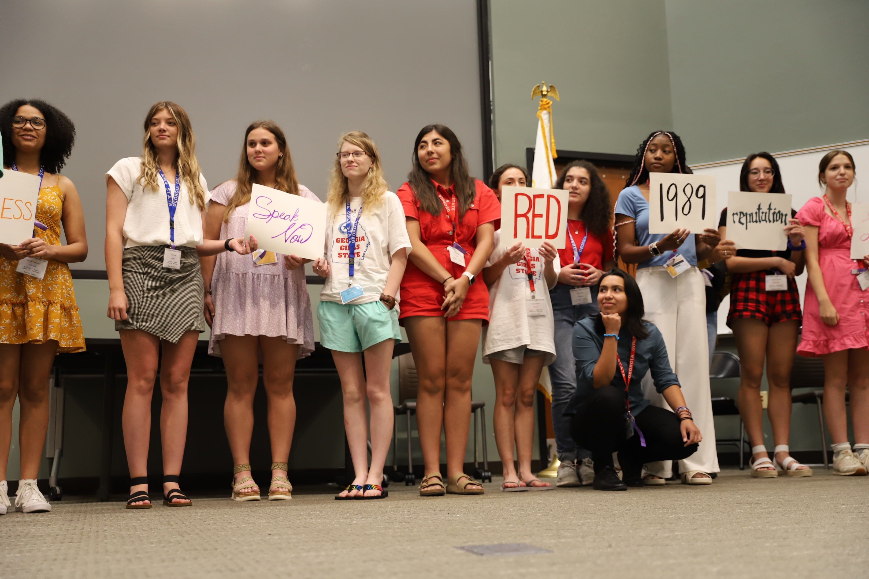
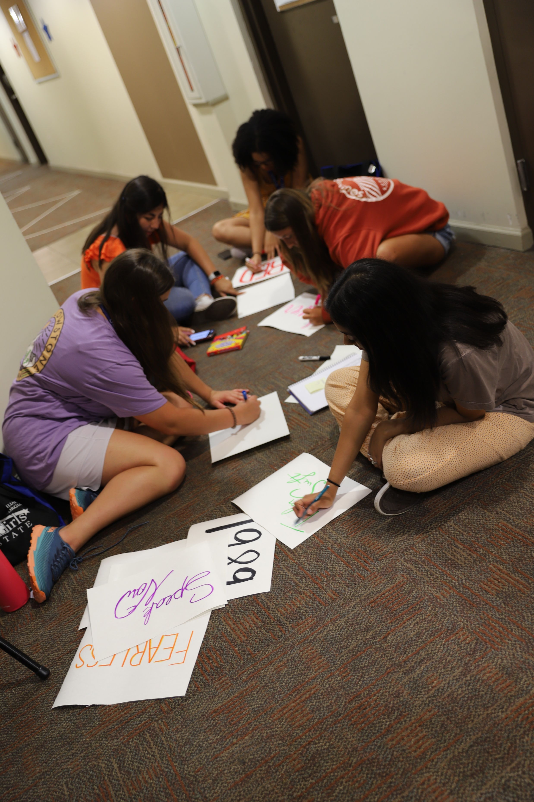
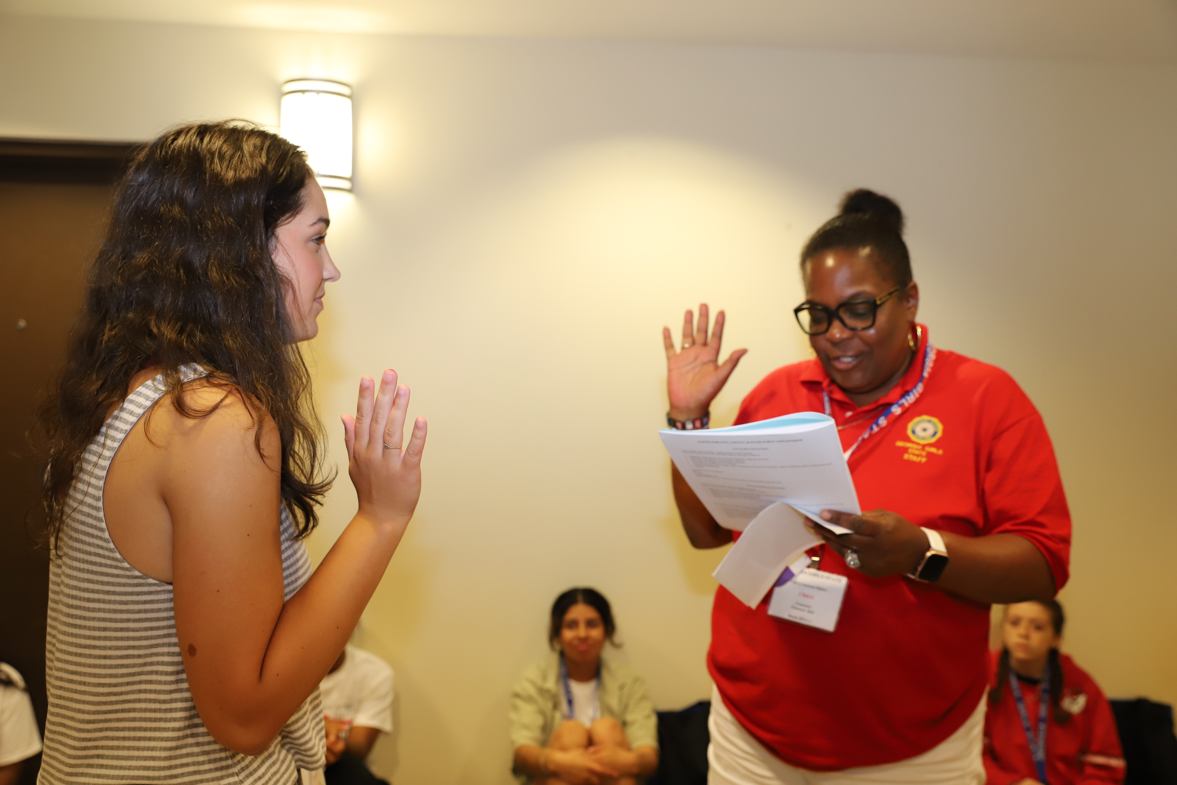
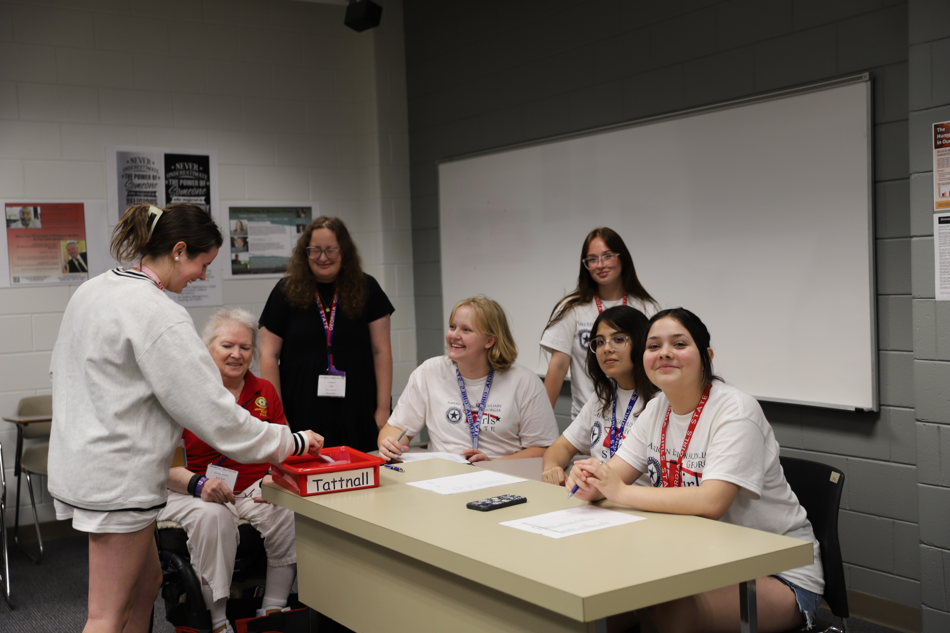
Inspirational Time
Making Campaign Signs
Swearing in Mayor
Voting

Slide 20
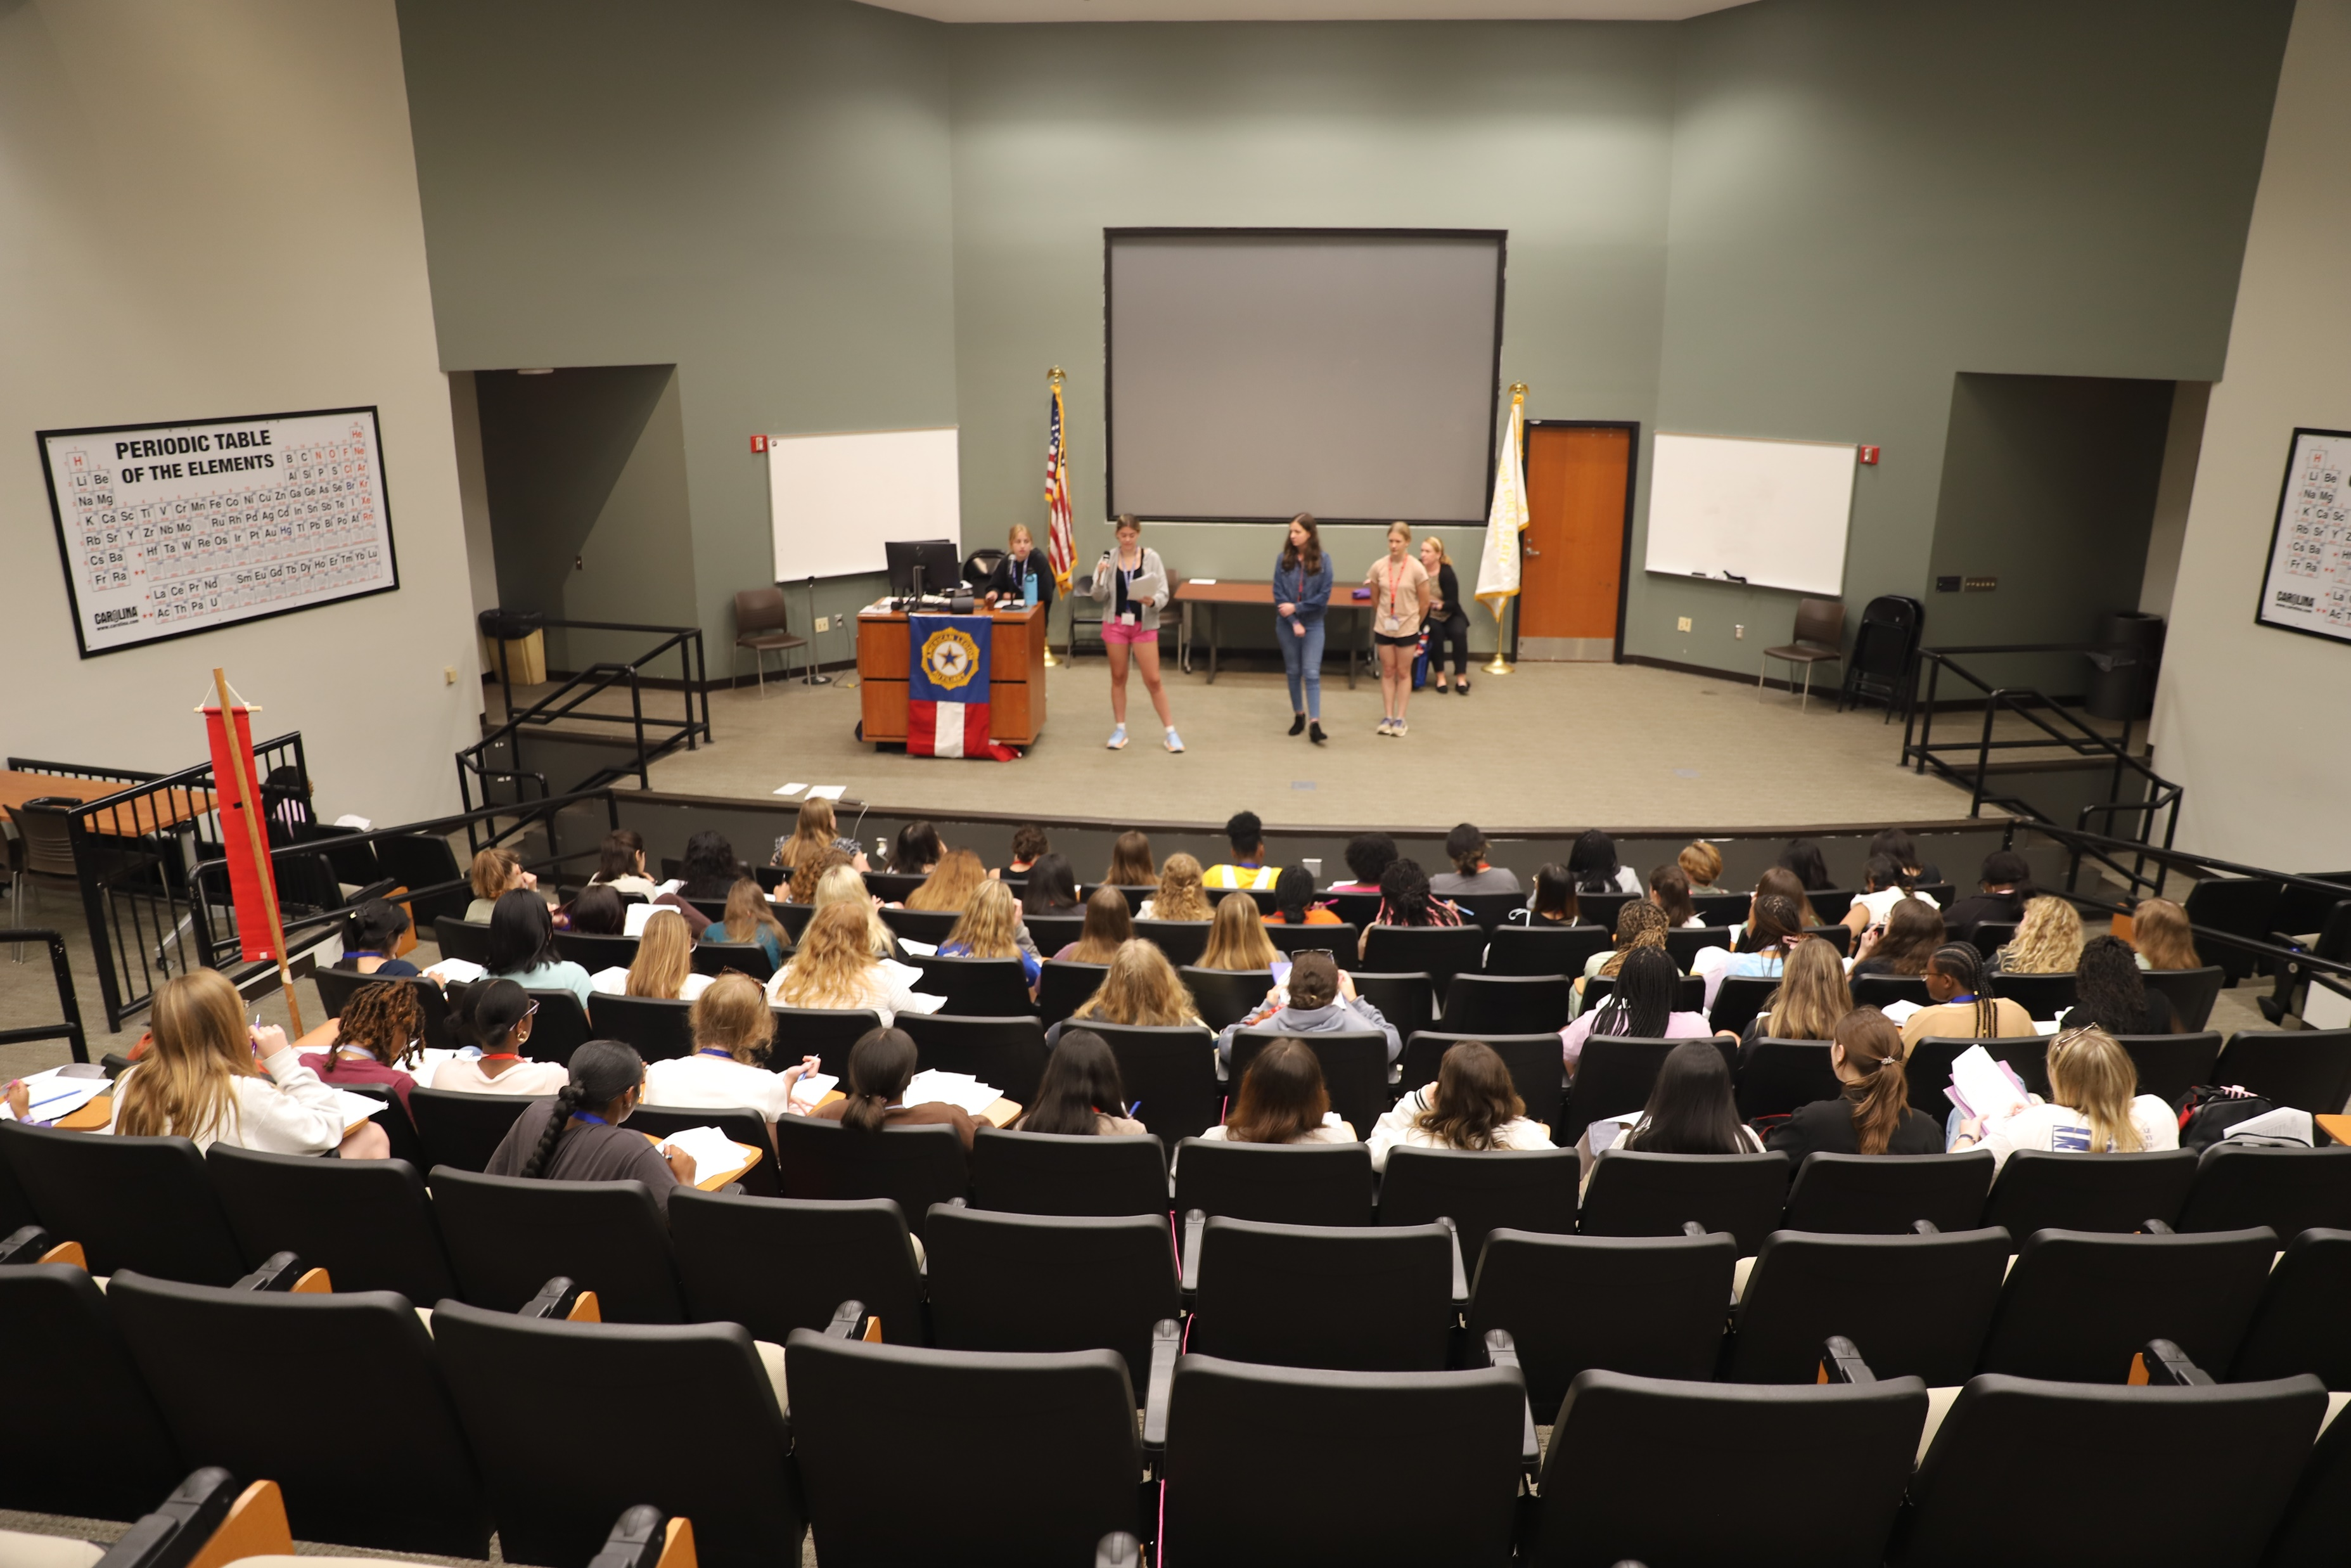
House of Representatives Session

Slide 21
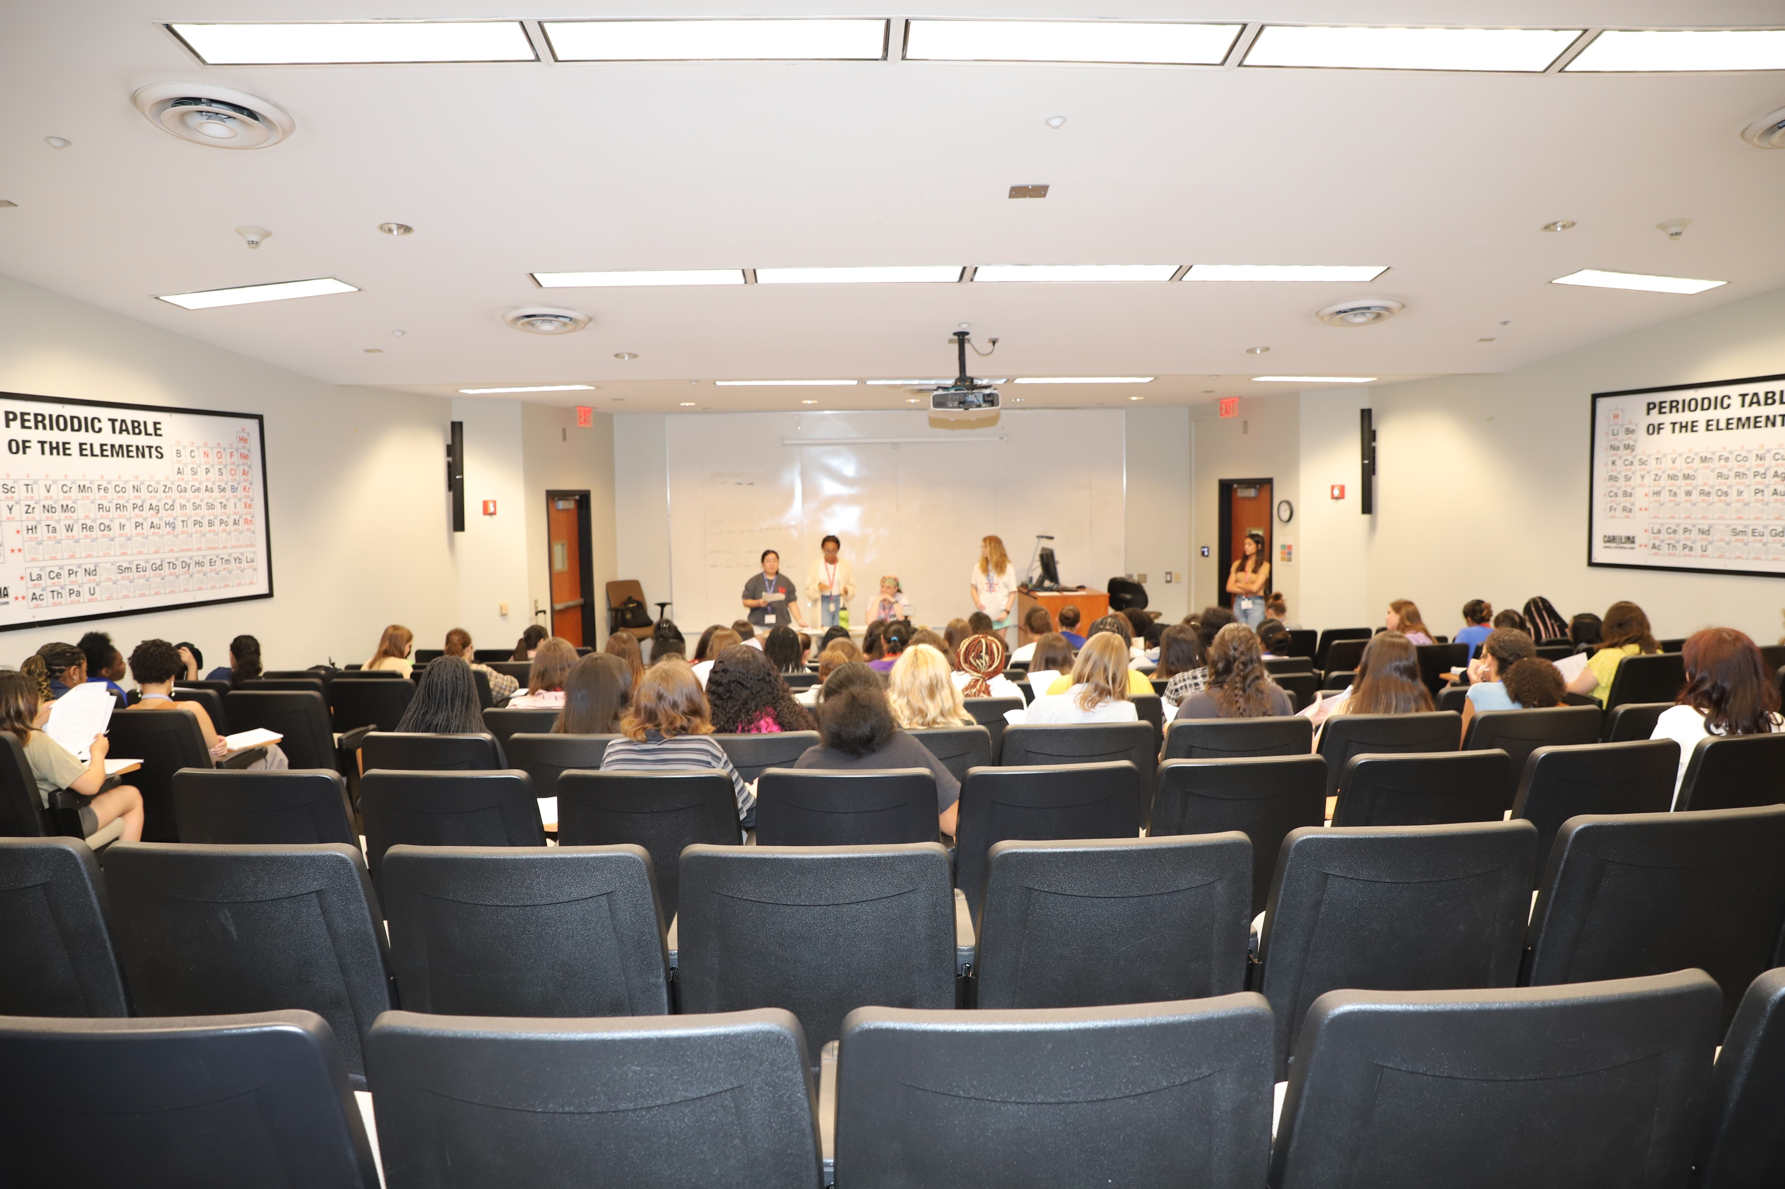
Senate Session

Slide 22
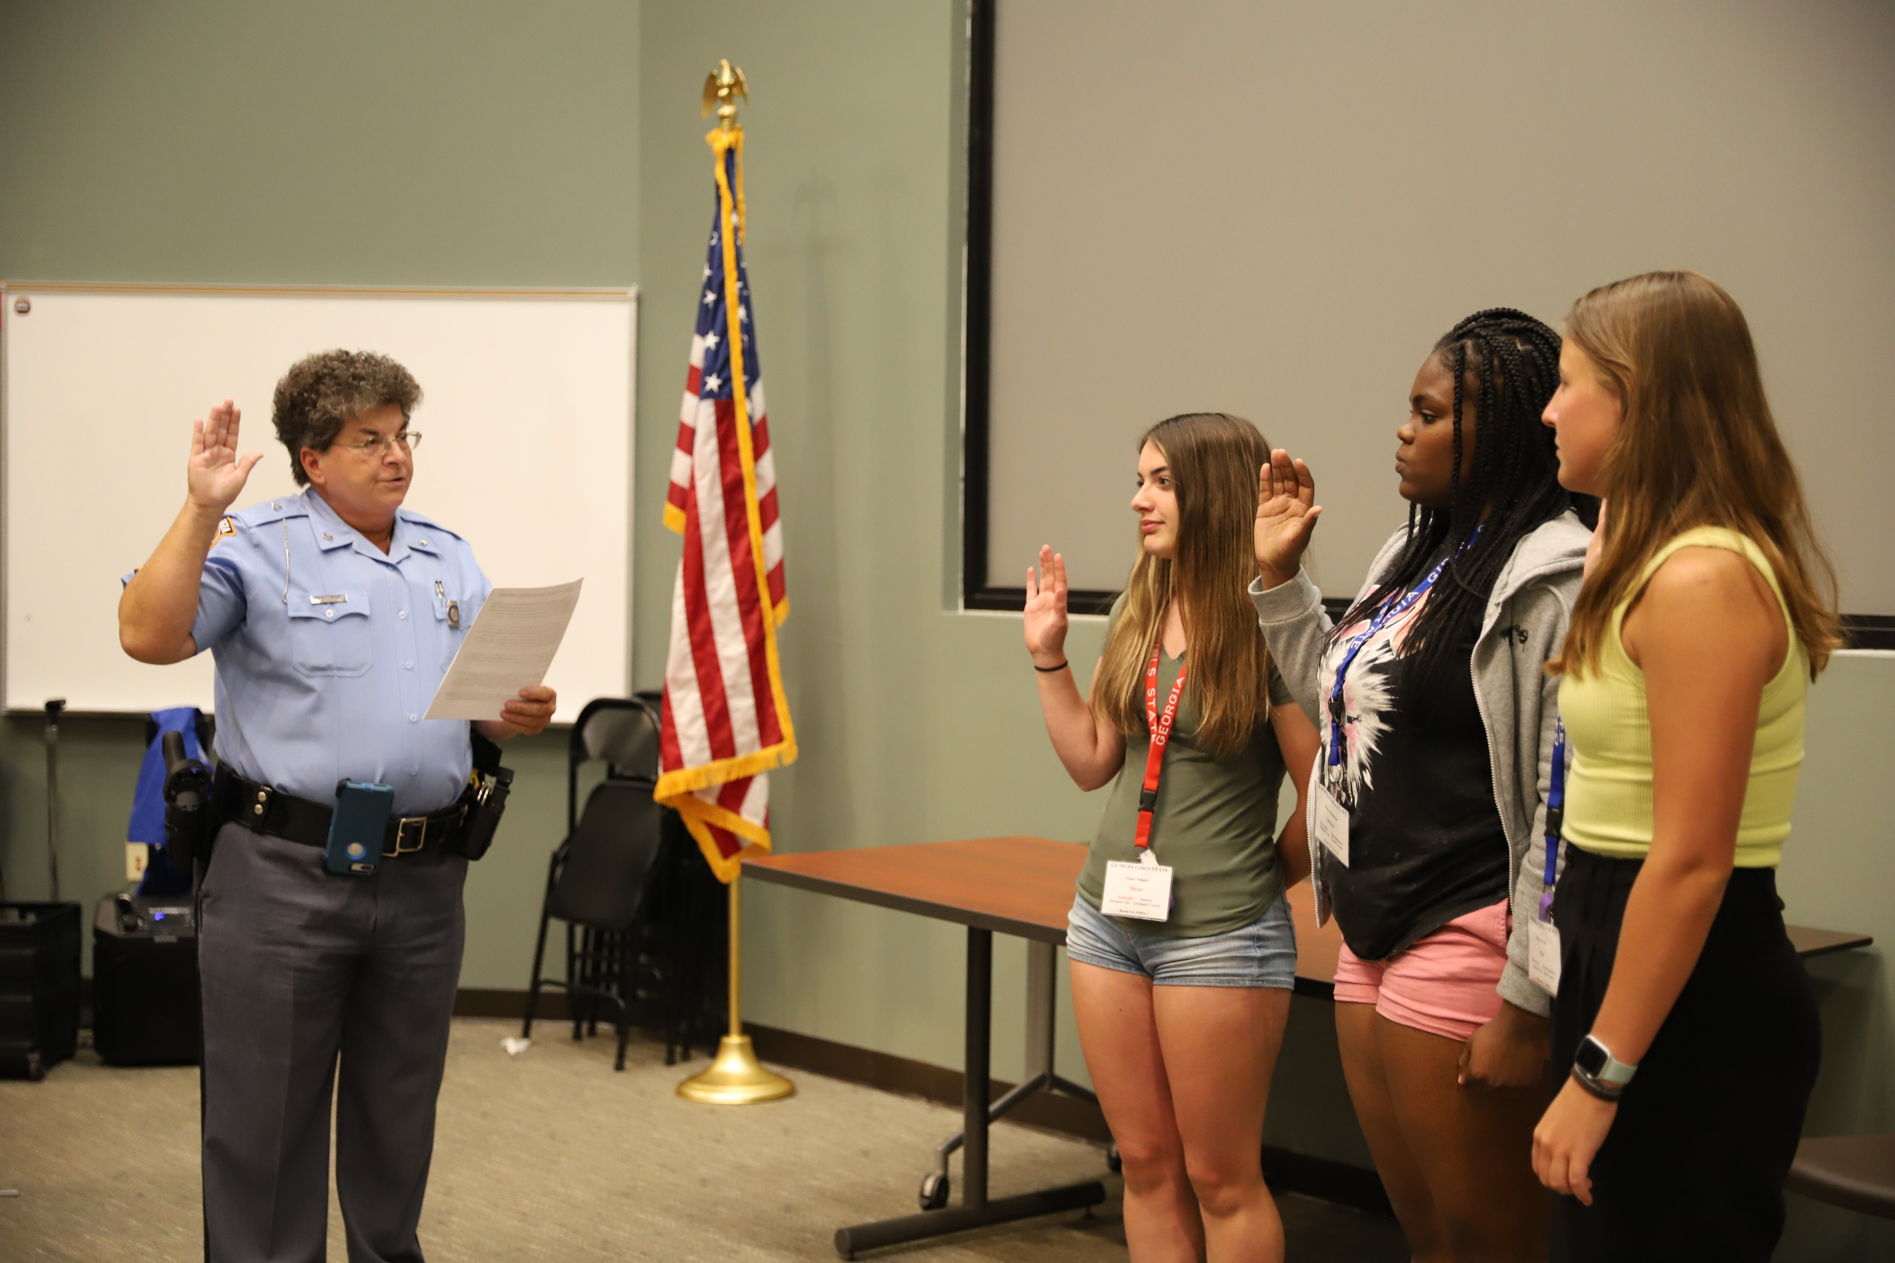
Swearing in County Officers

Slide 23
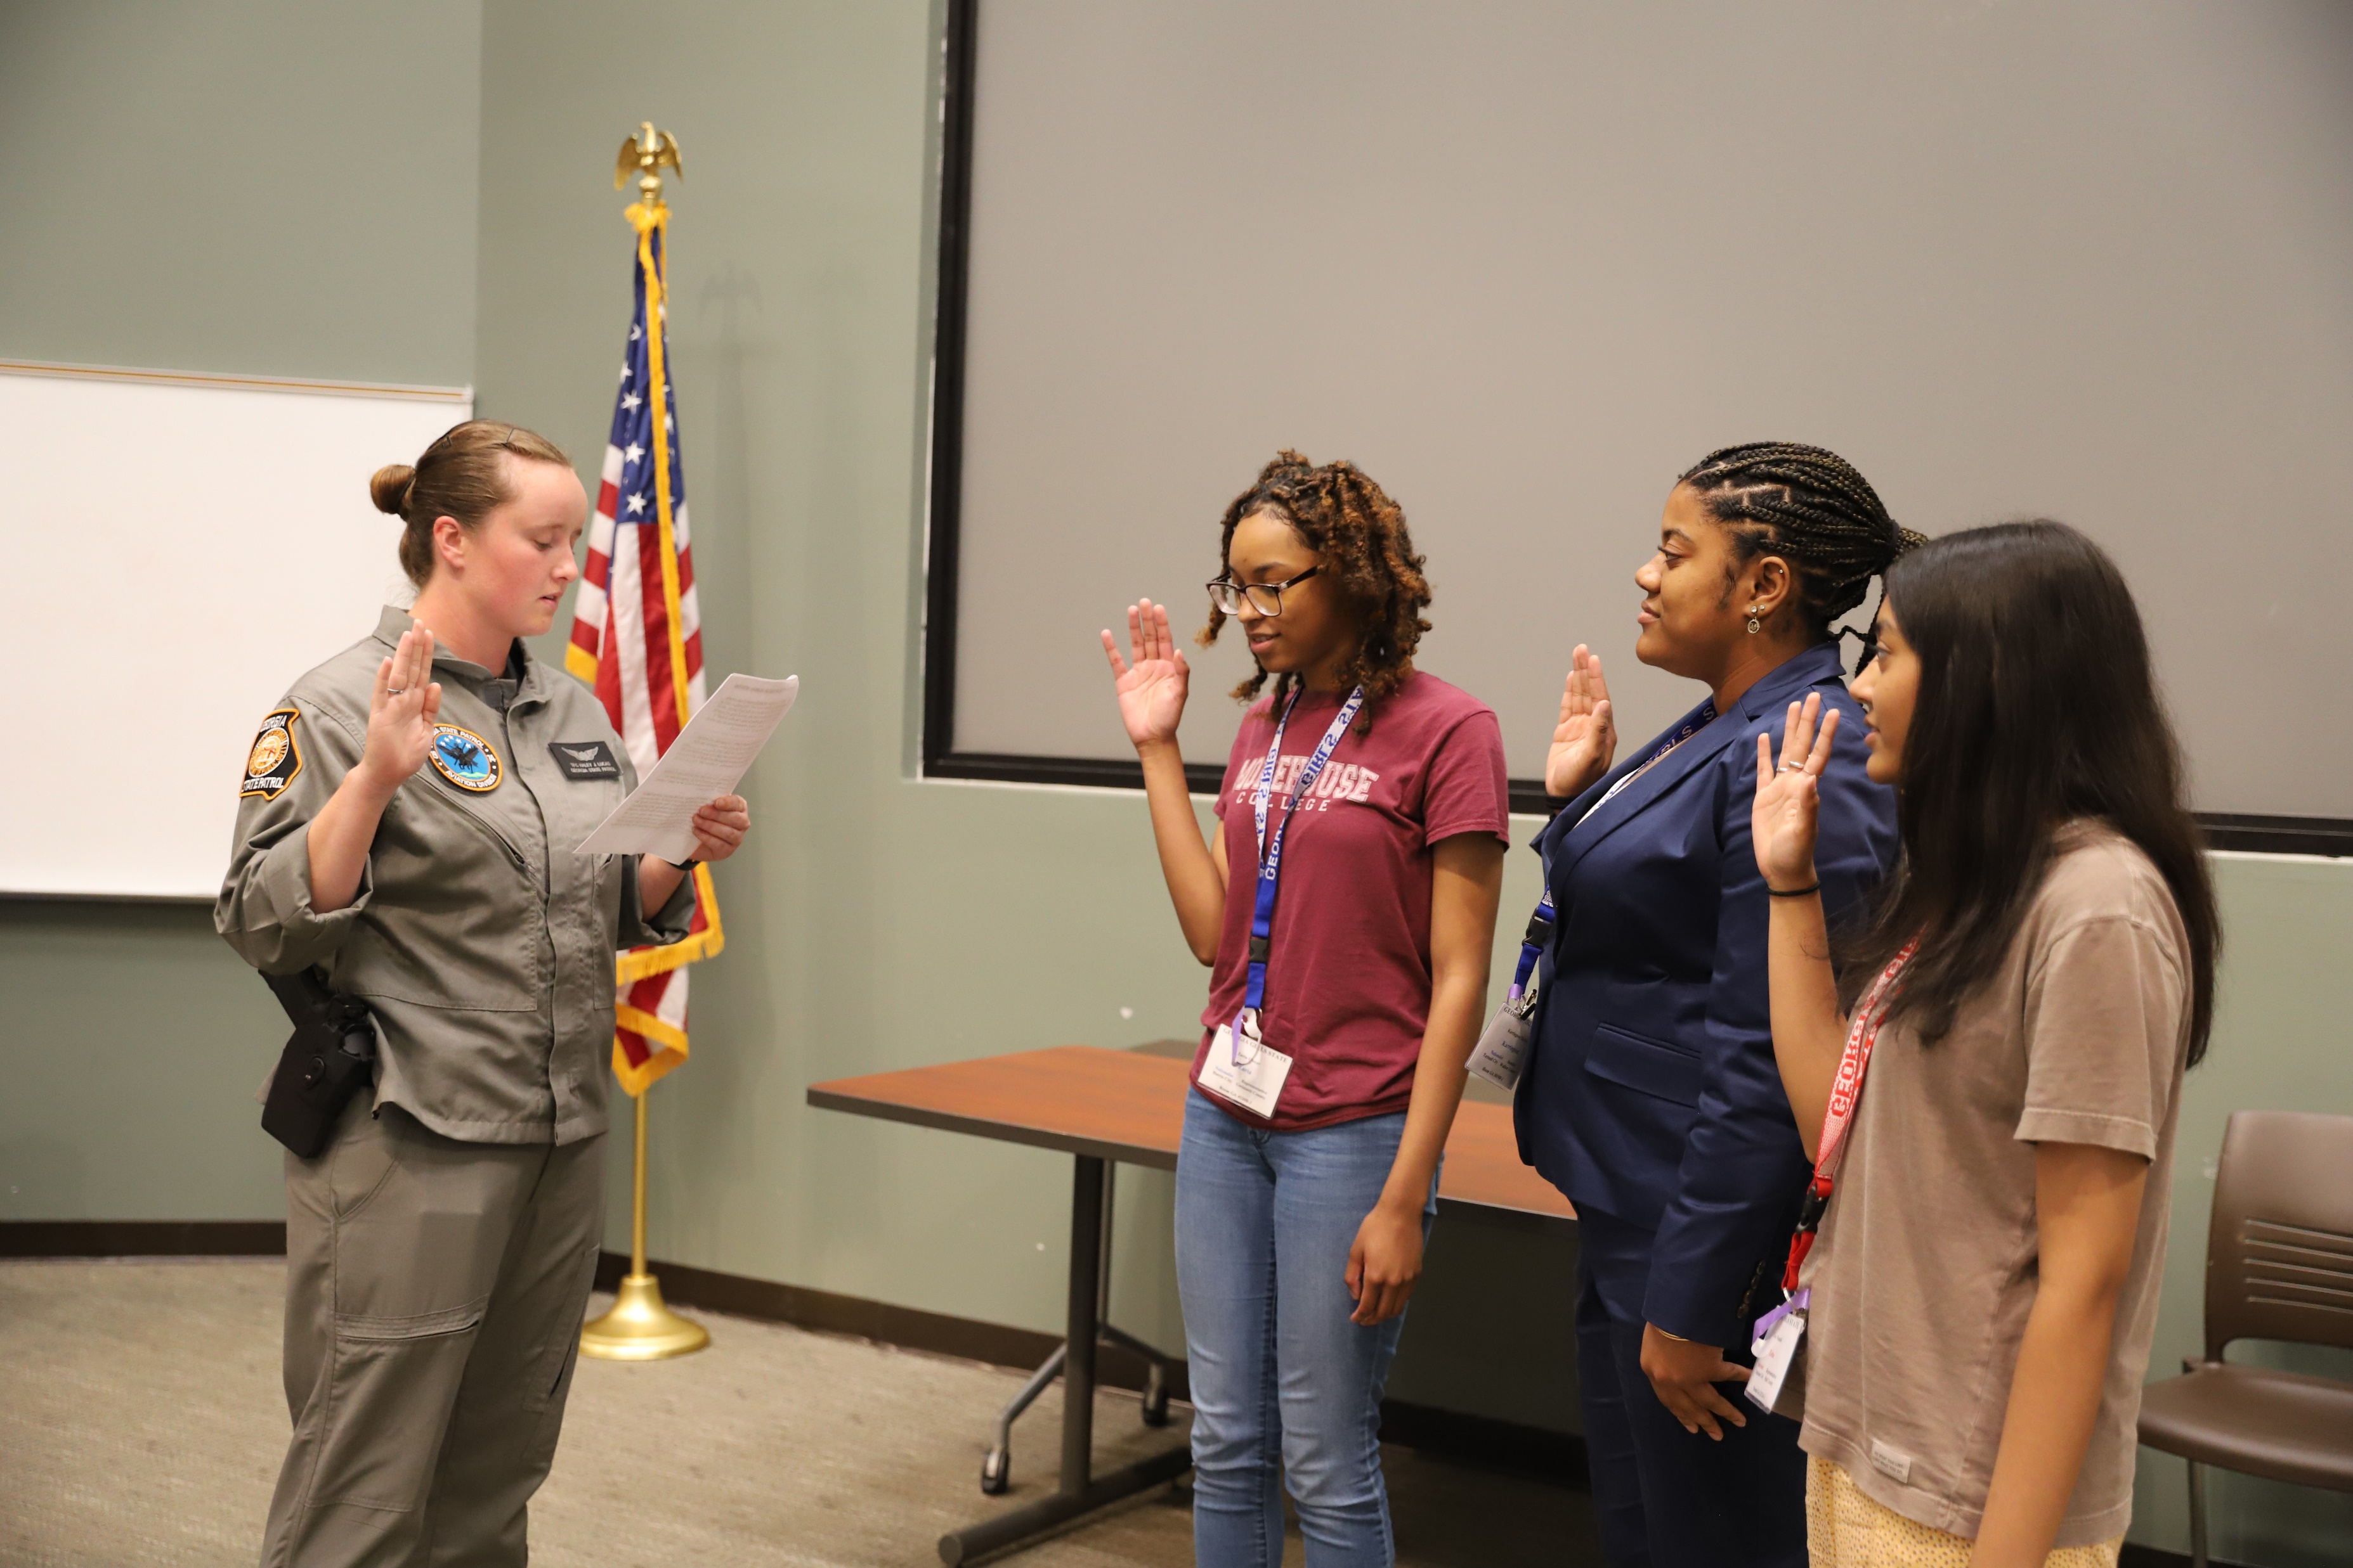

Slide 24
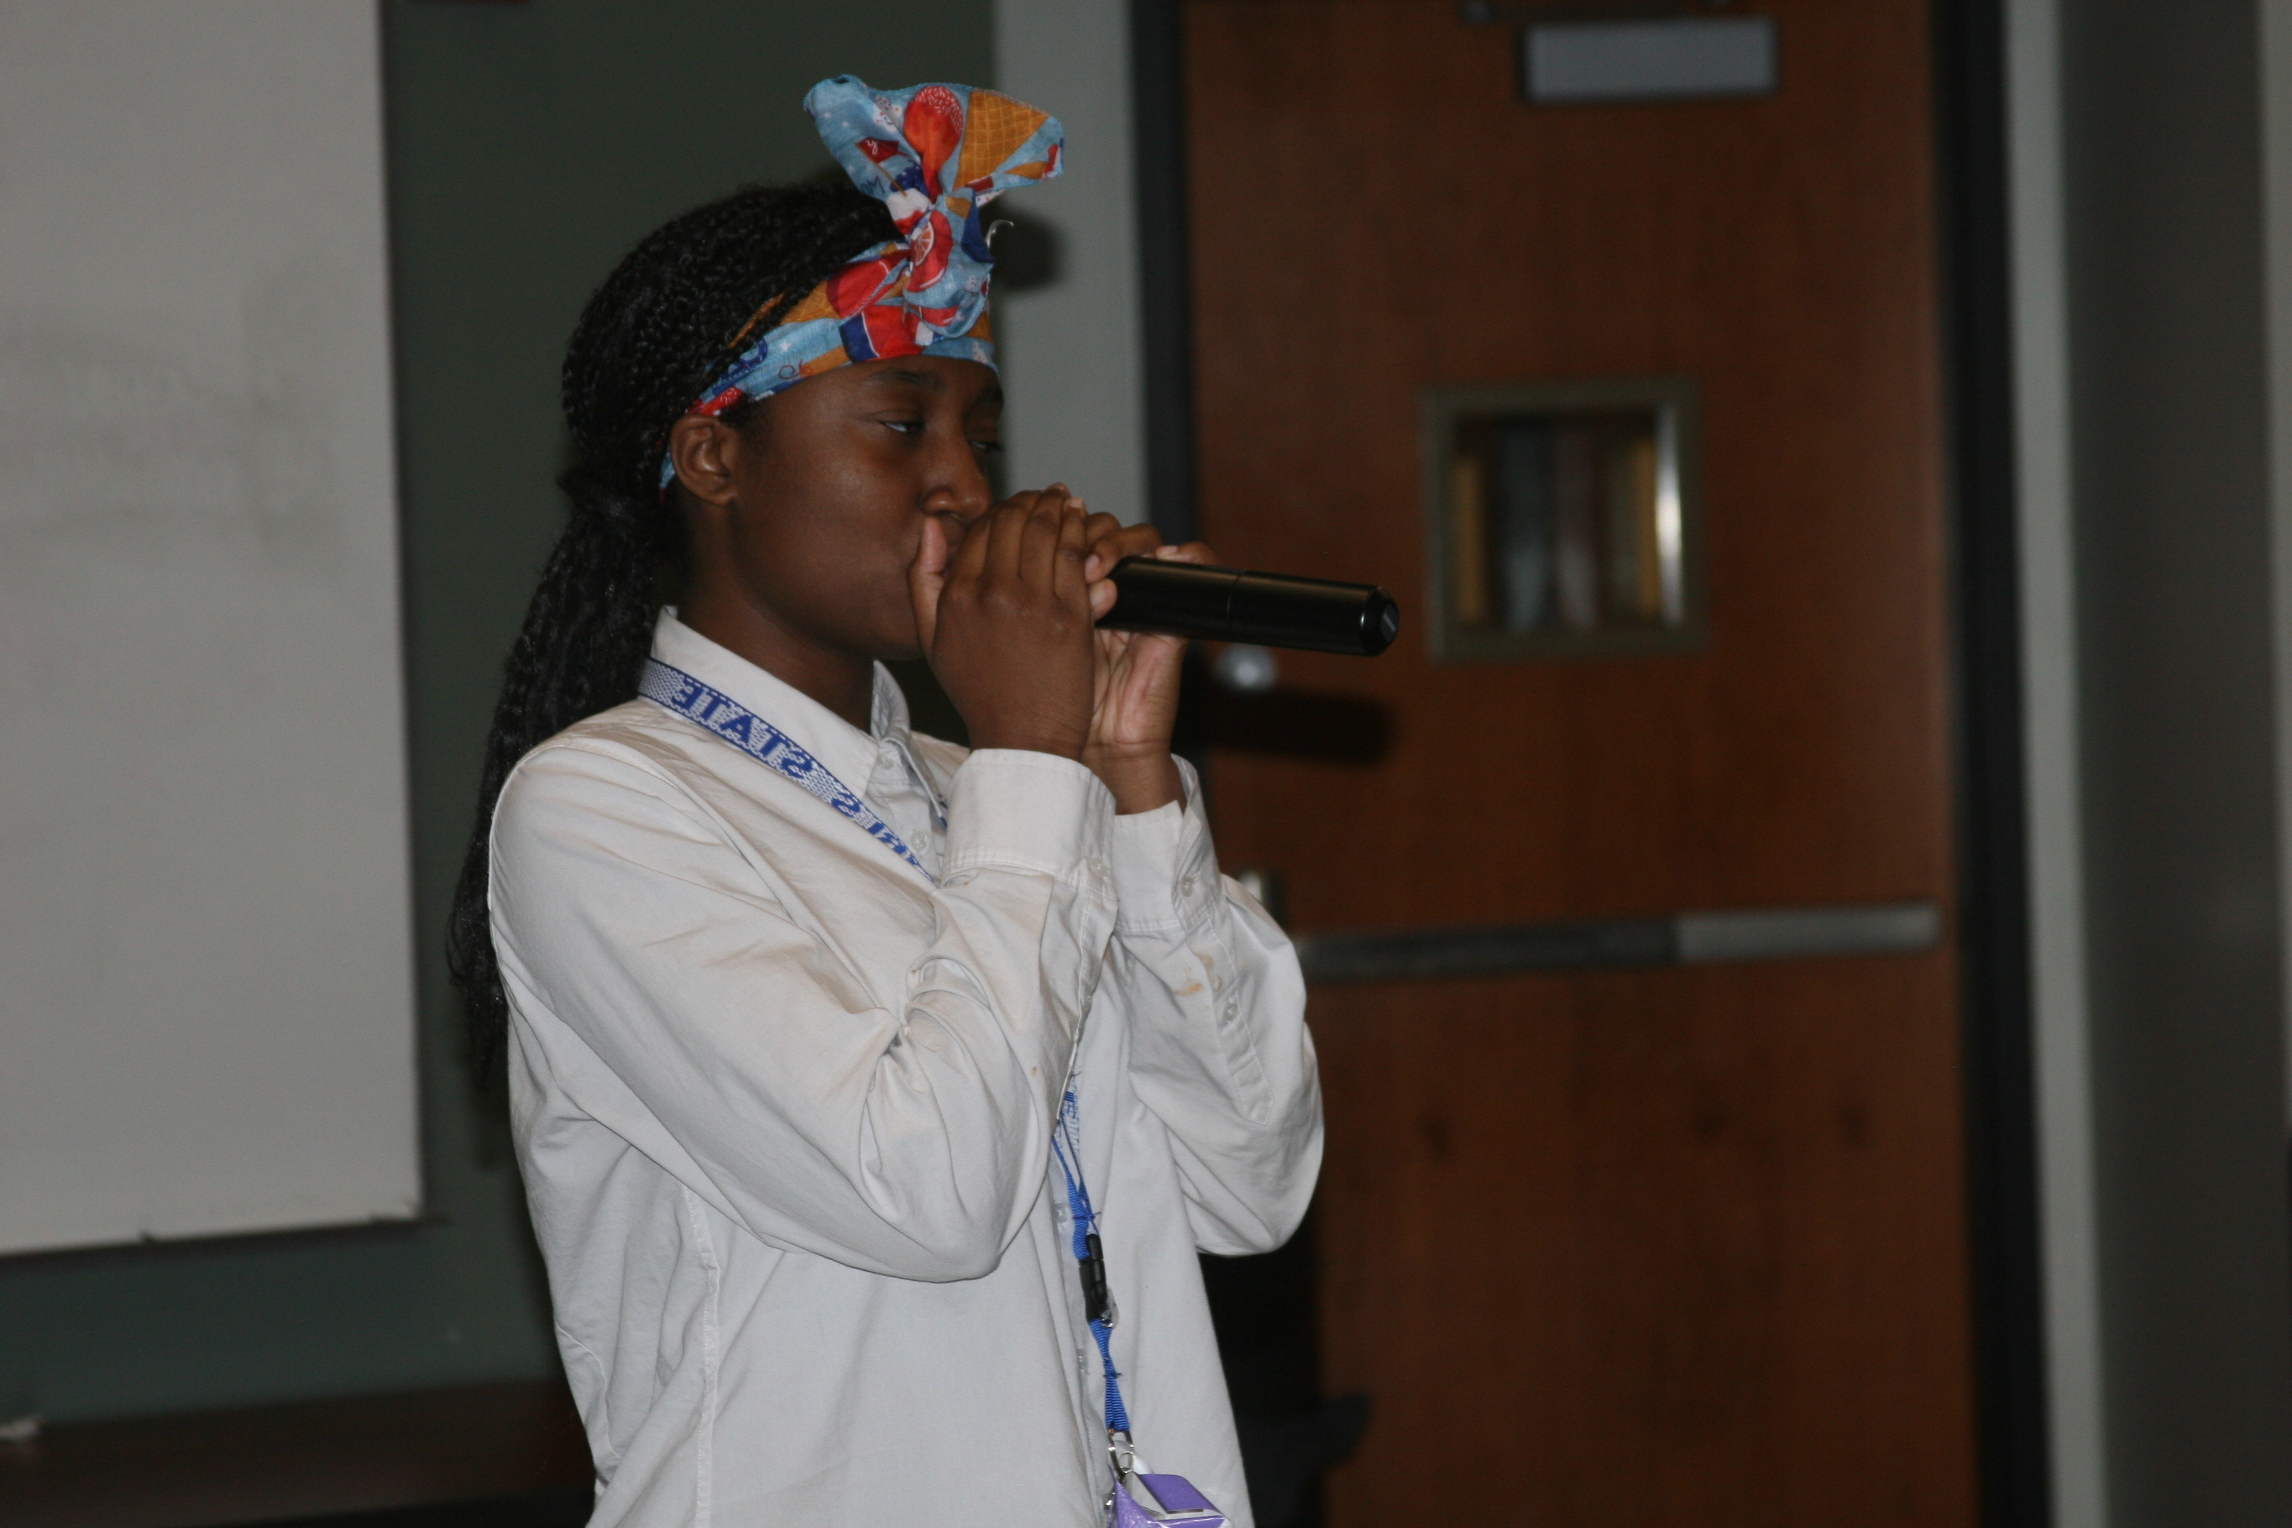
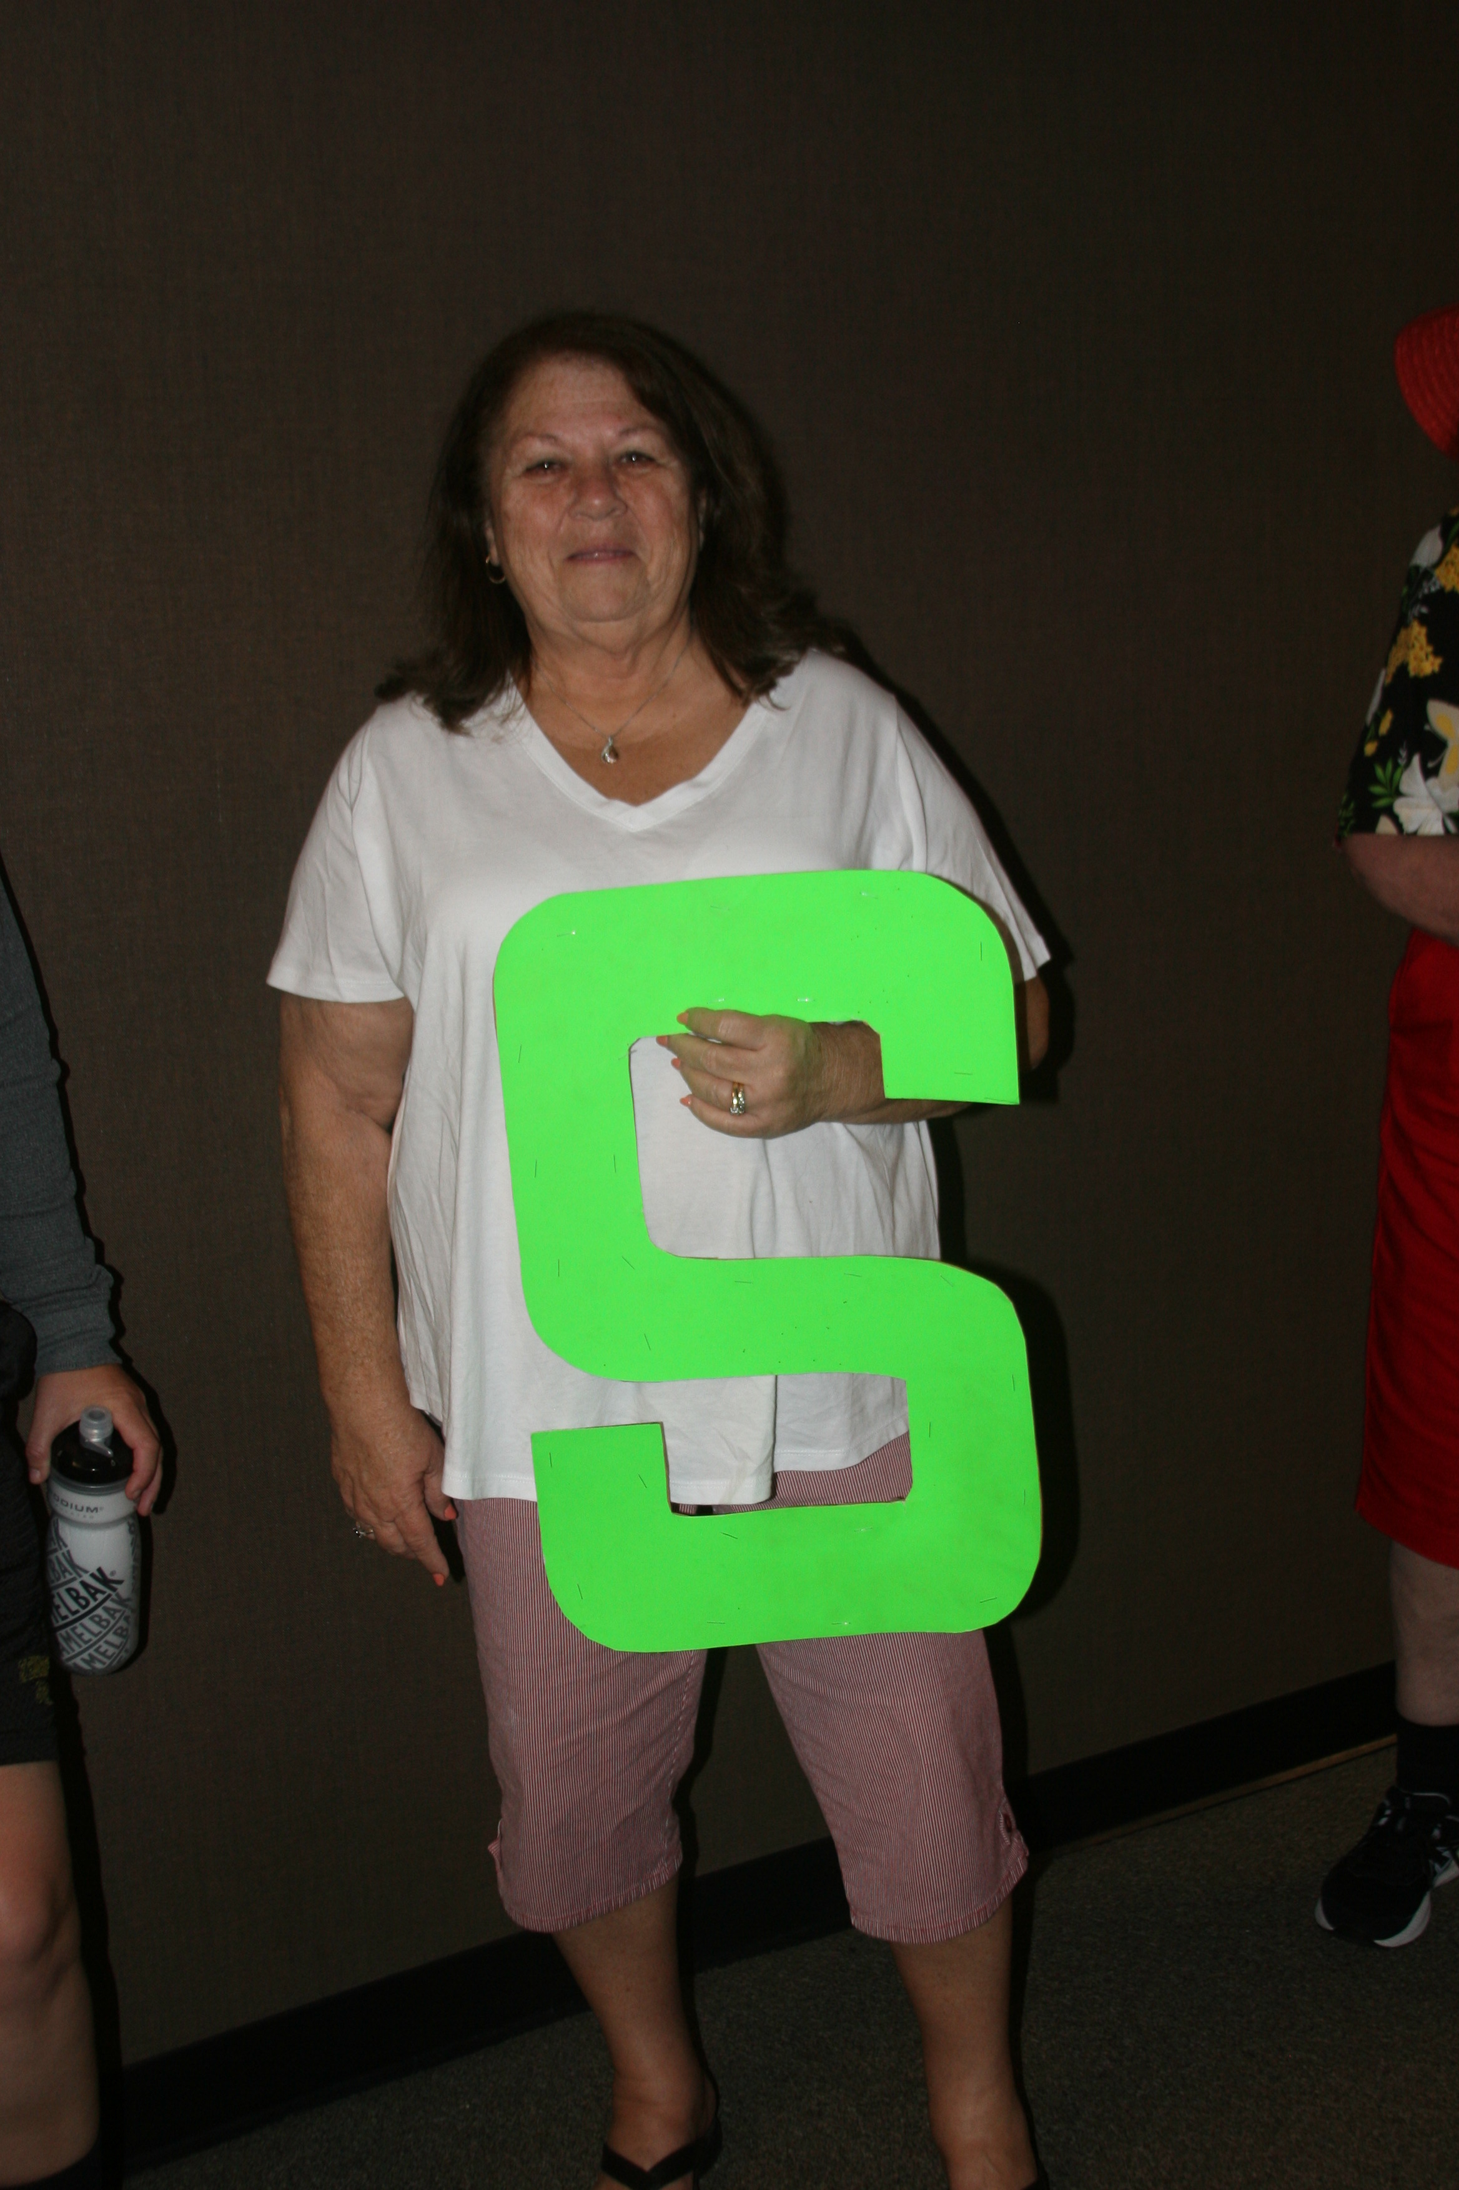
Talent Show and Staff Skit

Slide 25
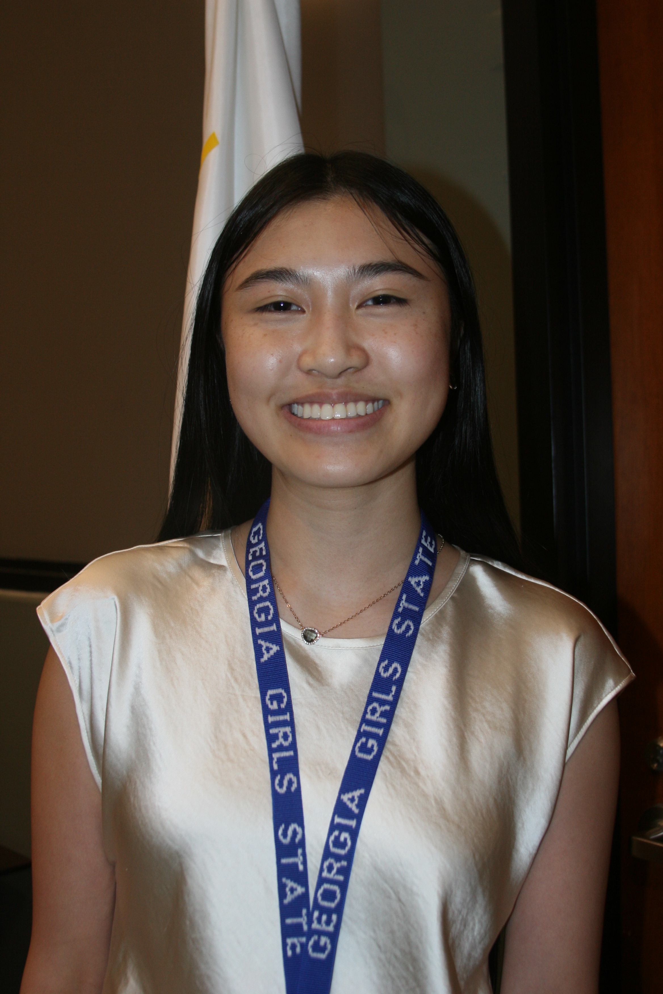
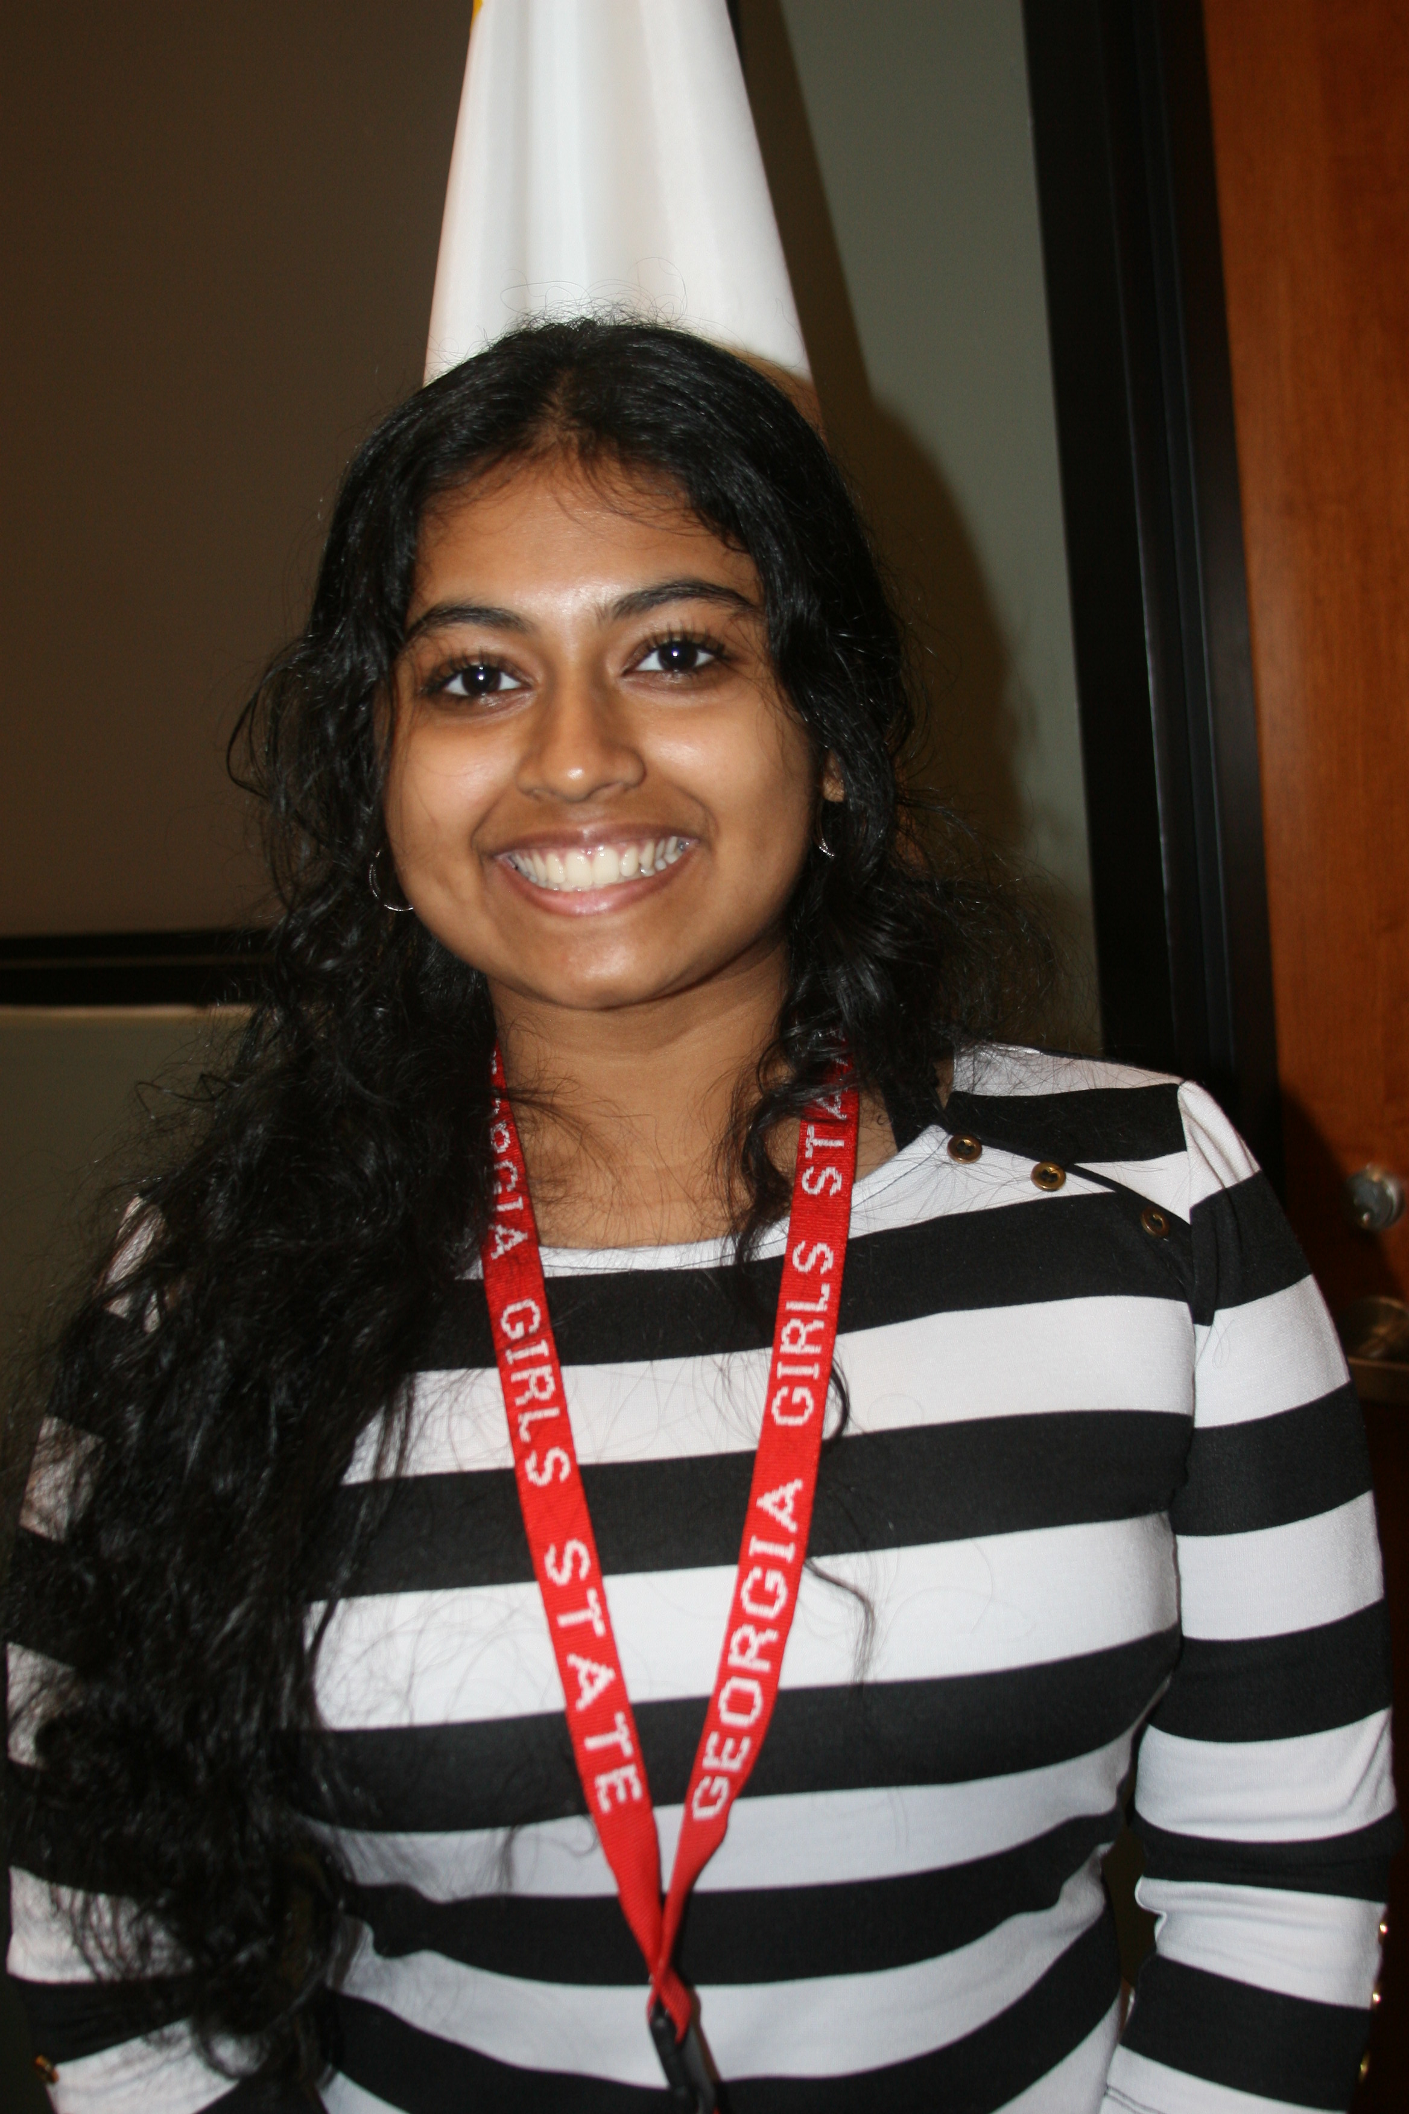
US Senators

Slide 26
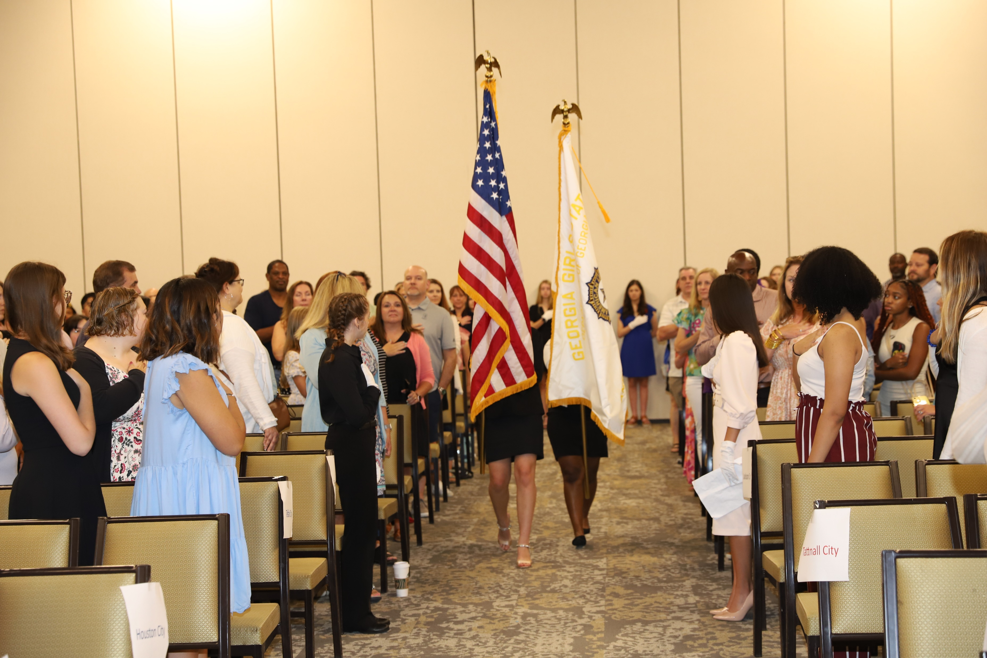
Flags being posted

Slide 27
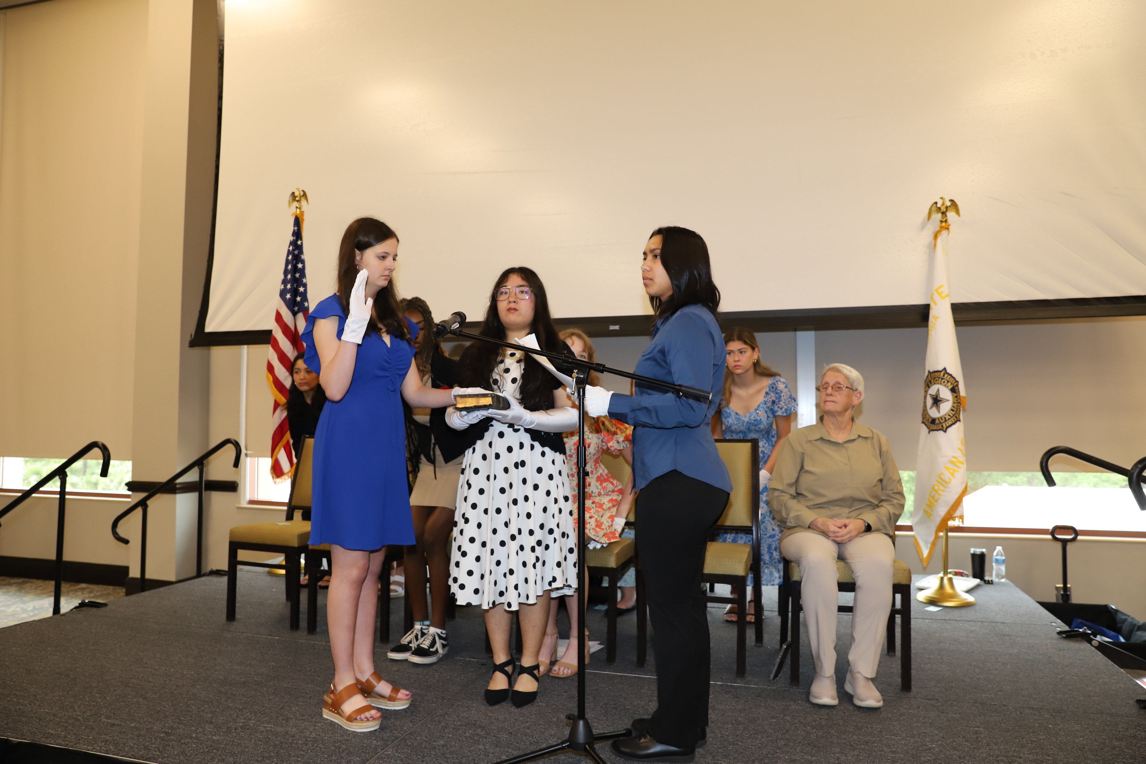
Inauguration of the Governor and other State Officials

Slide 28
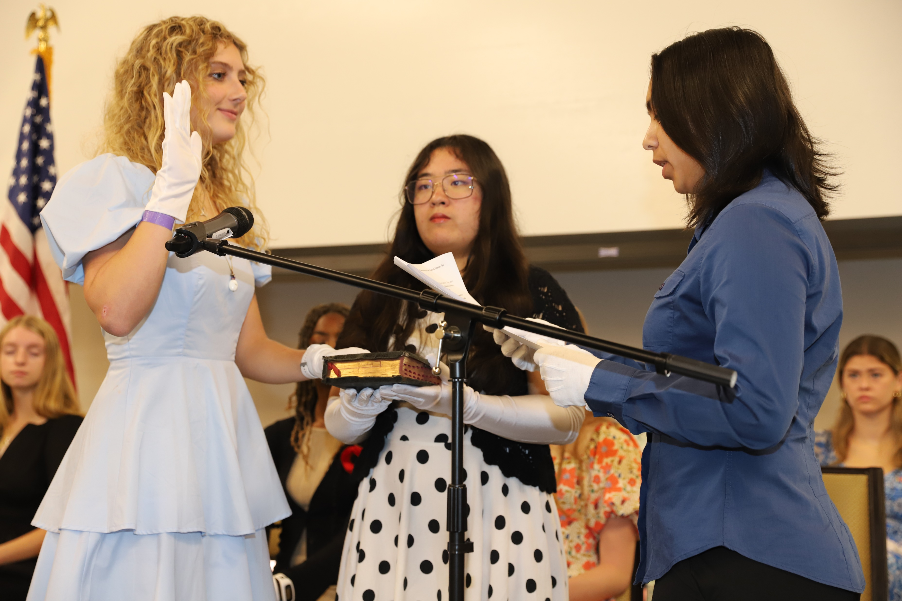

Slide 29
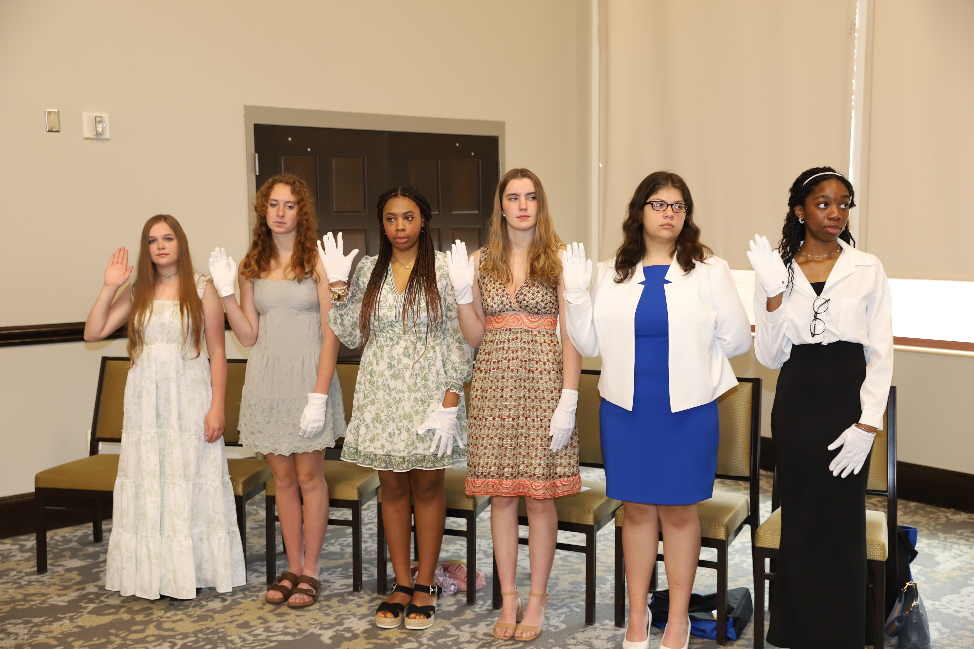

Slide 30
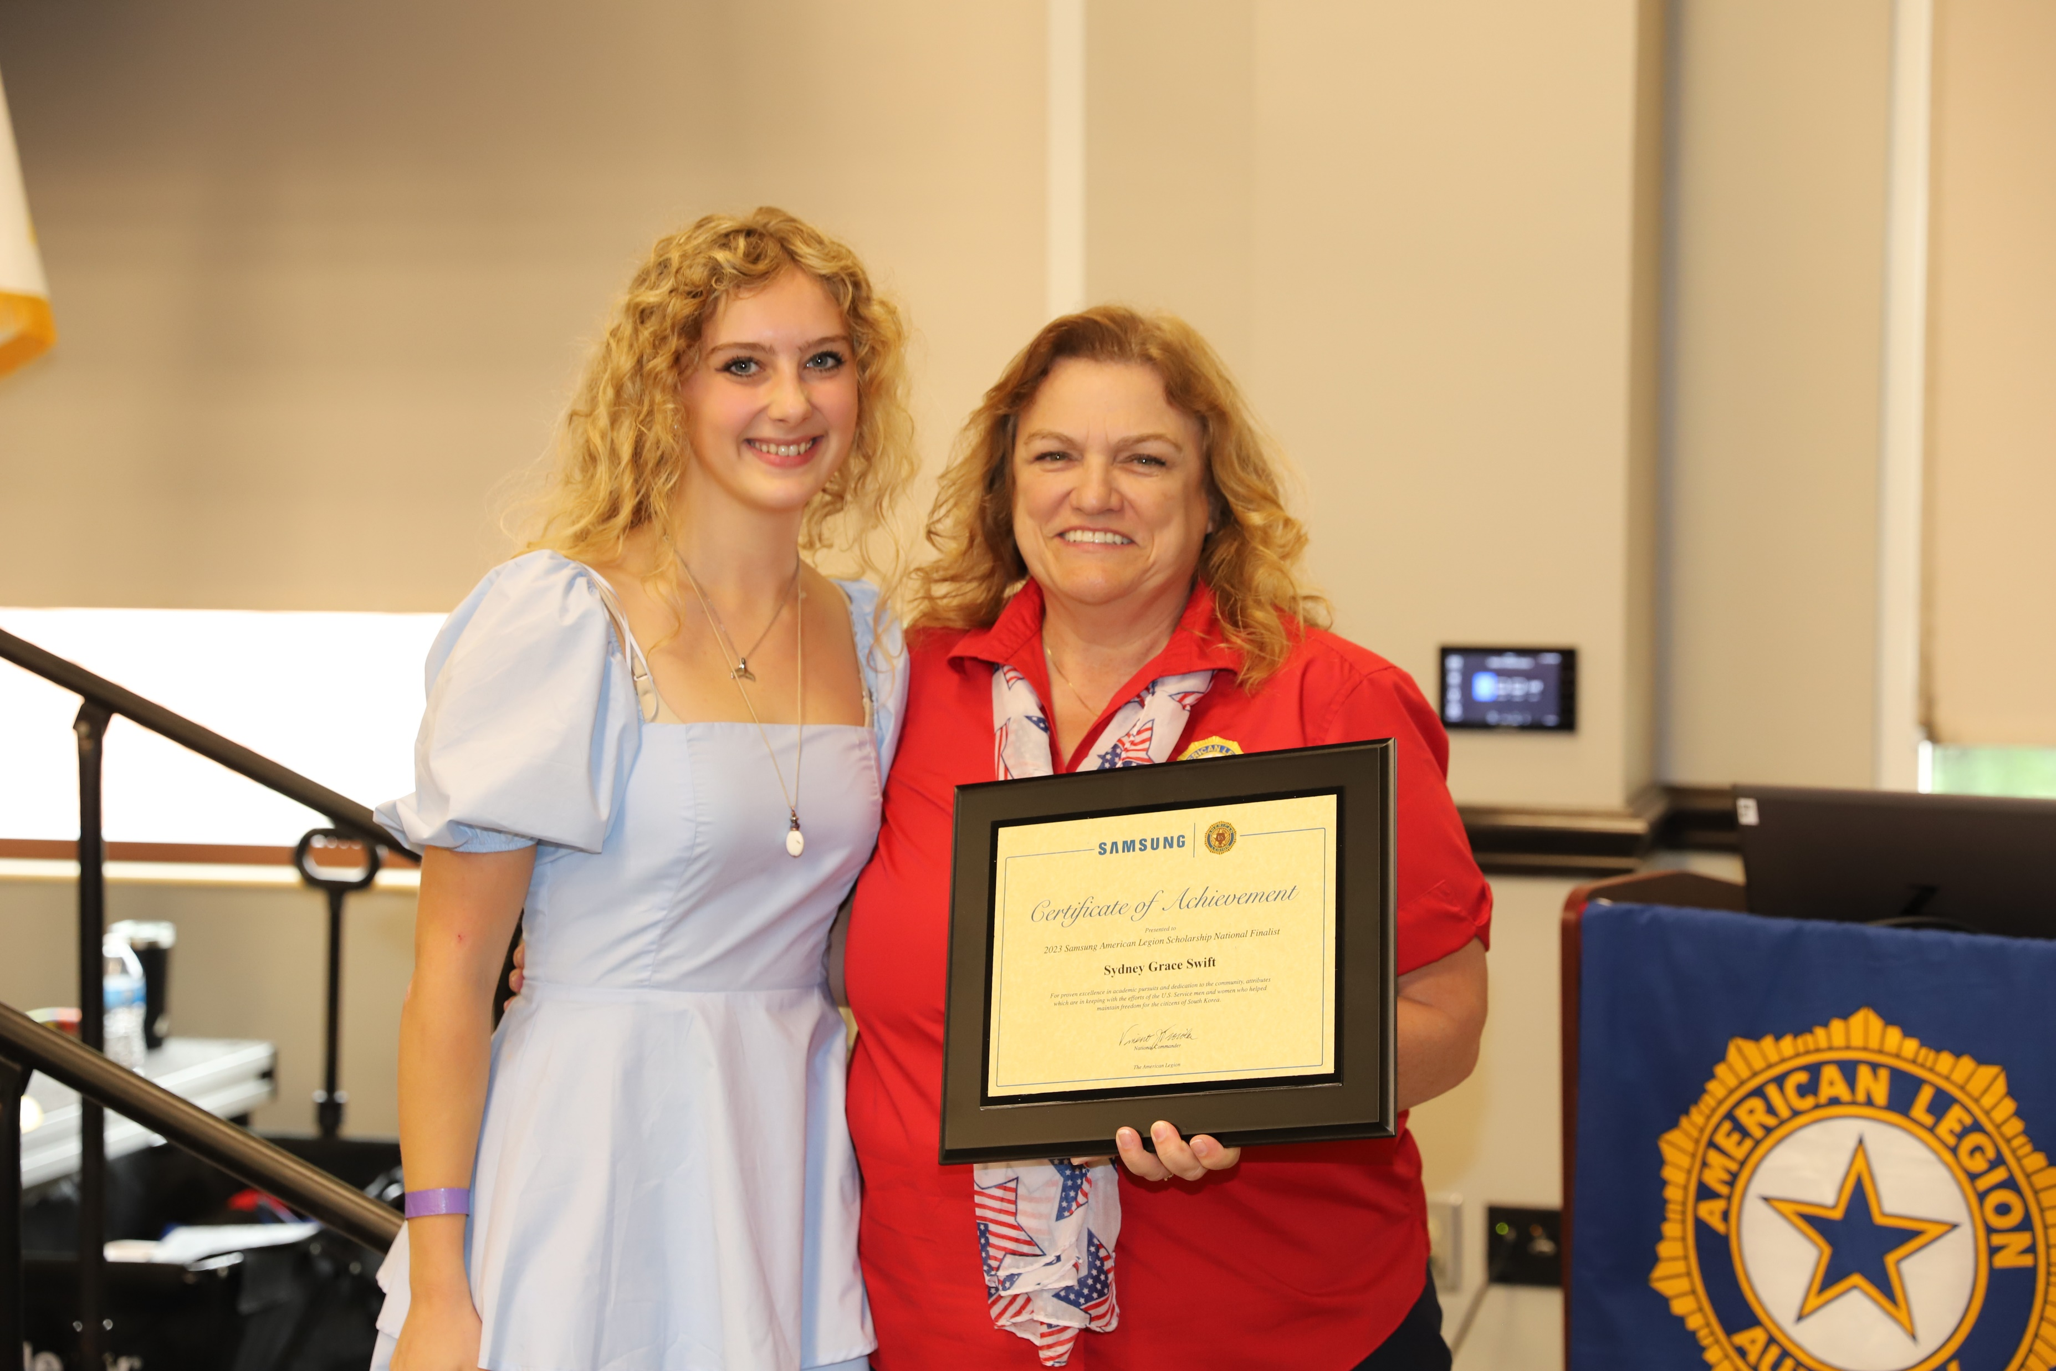
Presentation of the Samsung Scholarship Award

Slide 31
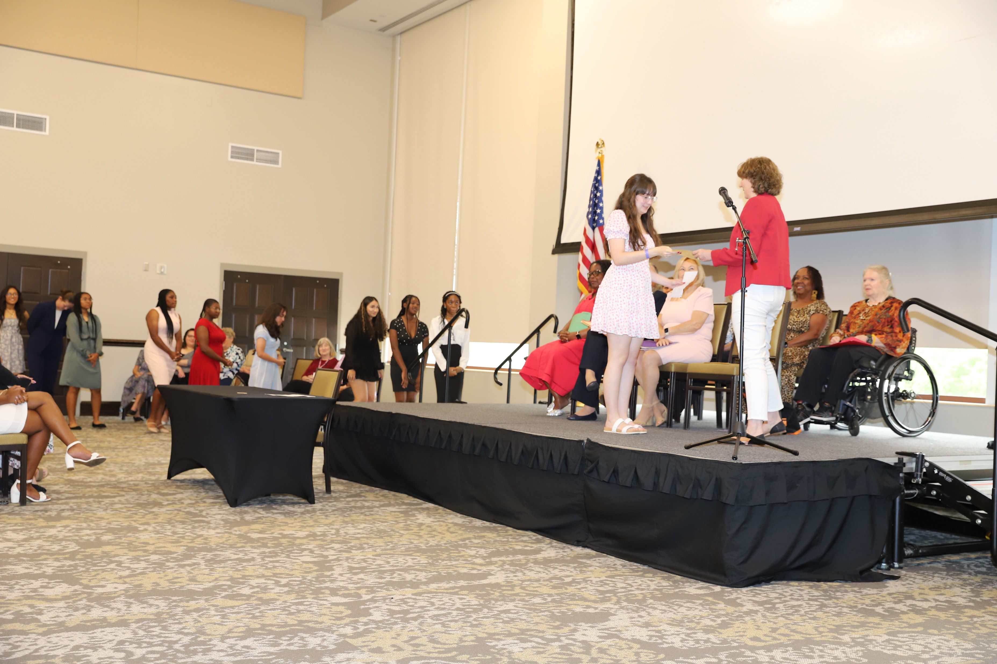
Presentation of Certificates at Graduation

